Slide 1
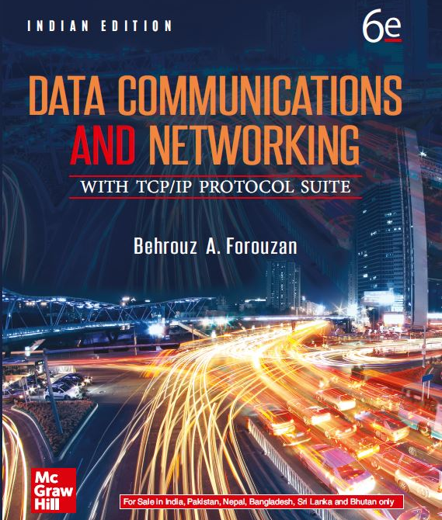
Chapter 07
Network Layer: Data Transfer
Data Communications and Networking, With TCP/IP protocol suite Sixth Edition
Behrouz A. Forouzan
© 2022 McGraw Hill, LLC. All rights reserved. Authorized only for instructor use in the classroom.
No reproduction or further distribution permitted without the prior written consent of McGraw Hill, LLC.

Slide 2
Chapter 7: Outline
7.1 Services
7.2 Packet Switching
7.3 Performance
7.4 Internet Protocol V4
7.5 Internet Protocol V6
7.6 Transition from V4 To V6

Slide 3
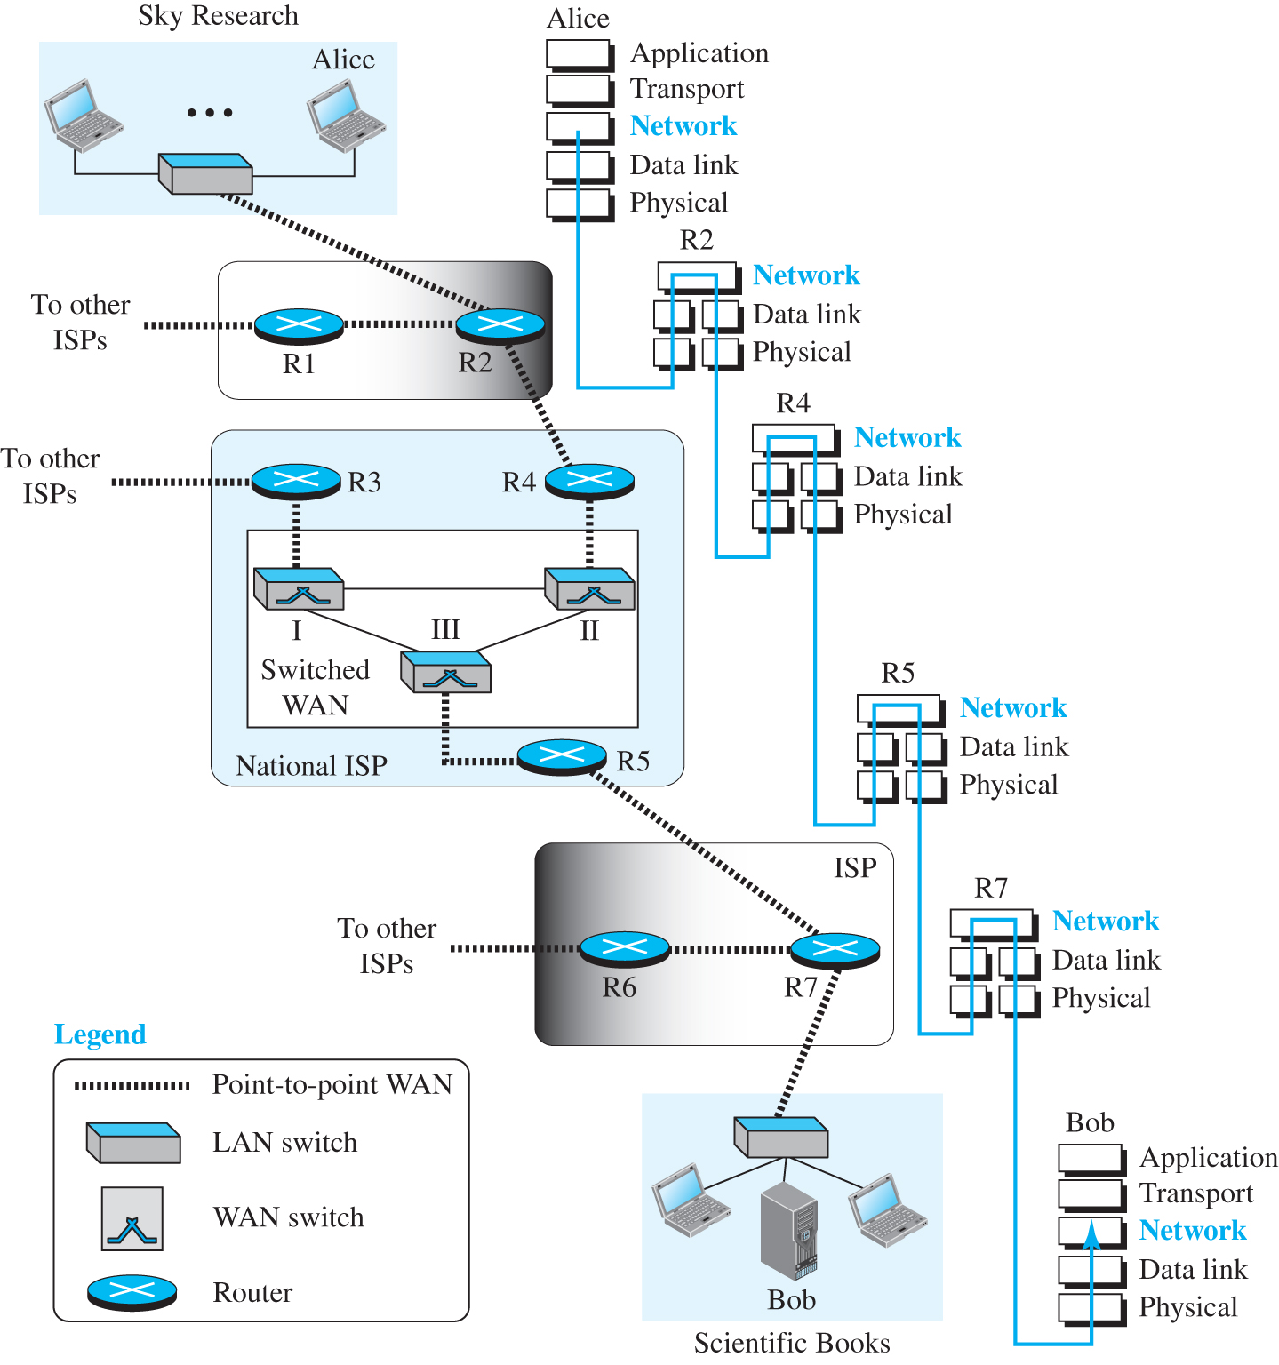
Figure 7.1 Communication at the network layer
Access the text alternative for slide images.

Slide 4
7-1 SERVICES
We briefly discuss the services provided at the network layer.

Slide 5
7.1.1 Packetizing
The first duty of the network layer is definitely packetizing: encapsulating the payload in a network-layer packet at the source and decapsulating the payload from the network-layer packet at the destination. In other words, one duty of the network layer is to carry a payload from the source to the destination without changing it or using it. The network layer is doing the service of a carrier such as the postal office, which is responsible for delivery of packages from a sender to a receiver without changing or using the contents.

Slide 6
7.1.2 Routing
Other duties of the network layer, which are as important as the first, are routing and forwarding, which are directly related to each other.

Slide 7
7.1.3 Error Control
Although error control can be implemented in the network layer, the designers of the network layer in the Internet ignored this issue for the data being carried by the network layer. One reason for this decision is the fact that the packet in the network layer may be fragmented at each router, which makes error checking at this layer inefficient.

Slide 8
7.1.4 Flow Control
Flow control regulates the amount of data a source can send without overwhelming the receiver. If the upper layer at the source computer produces data faster than the upper layer at the destination computer can consume it, the receiver will be overwhelmed with data. To control the flow of data, the receiver needs to send some feedback to the sender to inform the latter that it is overwhelmed with data.

Slide 9
7.1.5 Congestion Control
Another issue in a network-layer protocol is congestion control. Congestion in the network layer is a situation in which too many datagrams are present in an area of the Internet. Congestion may occur if the number of datagrams sent by source computers is beyond the capacity of the network or routers.

Slide 10
7.1.6 Quality of Service
As the Internet has allowed new applications such as multimedia communication (in particular real-time communication of audio and video), the quality of service (QoS) of the communication has become more and more important. The Internet has thrived by providing better quality of service to support these applications. However, to keep the network layer untouched, these provisions are mostly implemented in the upper layer.

Slide 11
7.1.7 Security
Another issue related to communication at the network layer is security. Security was not a concern when the Internet was originally designed because it was used by a small number of users at universities for research activities; other people had no access to the Internet. The network layer was designed with no security provision. Today, however, security is a big concern. To provide security for a connectionless network layer, we need to have another virtual level that changes the connectionless service to a connection-oriented service.

Slide 12
7-2 PACKET SWITCHING
From the discussion of routing and forwarding in the previous section, we infer that a kind of switching occurs at the network layer. A router, in fact, is a switch that creates a connection between an input port and an output port (or a set of output ports), just as an electrical switch connects the input to the output to let electricity flow.

Slide 13
7.2.1 Datagram Approach
When the Internet started, to make it simple, the network layer was designed to provide a connectionless service in which the network-layer protocol treats each packet independently, with each packet having no relationship to any other packet. The idea was that the network layer is only responsible for delivery of packets from the source to the destination. In this approach, the packets in a message may or may not travel the same path to their destination.

Slide 14
7.2.2 Virtual-Circuit Approach
In a connection-oriented service (also called virtual-circuit approach), there is a relationship between all packets belonging to a message. Before all datagrams in a message can be sent, a virtual connection should be set up to define the path for the datagrams. After connection setup, the datagrams can all follow the same path. In this type of service, not only must the packet contain the source and destination addresses, it must also contain a flow label, a virtual circuit identifier that defines the virtual path the packet should follow.

Slide 15
7-3 PERFORMANCE
The upper-layer protocols that use the service of the network layer expect to receive an ideal service, but the network layer is not perfect. The performance of a network can be measured in terms of delay, throughput, and packet loss. Congestion control is an issue that can improve the performance.

Slide 16
7.3.1 Delay
All of us expect instantaneous response from a network, but a packet, from its source to its destination, encounters delays. The delays in a network can be divided into four types: transmission delay, propagation delay, processing delay, and queuing delay. Let us first discuss each of these delay types and then show how to calculate a packet delay from the source to the destination.

Slide 17
Transmission Delay 1
A source host or a router cannot send a packet instantaneously. A sender needs to put the bits in a packet on the line one by one. If the first bit of the packet is put on the line at time t1 and the last bit is put on the line at time t2, transmission delay of the packet is (t2 - t1). Definitely, the transmission delay is longer for a longer packet and shorter if the sender can transmit faster. In other words, the transmission delay is .

Slide 18
Propagation Delay
Propagation delay is the time it takes for a bit to travel from point A to point B in the transmission media. The propagation delay for a packet-switched network depends on the propagation delay of each network (LAN or WAN). The propagation delay depends on the propagation speed of the media, which is 3 ´ 108 meters/second in a vacuum and normally much less in a wired medium; it also depends on the distance of the link. In other words, propagation delay is .

Slide 19
Processing Delay
The processing delay is the time required for a router or a destination host to receive a packet from its input port, remove the header, perform an error detection procedure, and deliver the packet to the output port (in the case of a router) or deliver the packet to the upper-layer protocol (in the case of the destination host). The processing delay may be different for each packet, but normally is calculated as an average.

Slide 20
Total Delay
Assuming equal delays for the sender, routers, and receiver, the total delay (source-to-destination delay) a packet encounters can be calculated if we know the number of routers, n, in the whole path.

Slide 21
Transmission Delay 2
A source host or a router cannot send a packet instantaneously. A sender needs to put the bits in a packet on the line one by one. If the first bit of the packet is put on the line at time t1 and the last bit is put on the line at time t2, transmission delay of the packet is (t2 - t1). Definitely, the transmission delay is longer for a longer packet and shorter if the sender can transmit faster. In other words, the transmission delay is:

Slide 22
7.3.2 Throughput
Throughput at any point in a network is defined as the number of bits passing through the point in a second, which is actually the transmission rate of data at that point. In a path from source to destination, a packet may pass through several links (networks), each with a different transmission rate. How, then, can we determine the throughput of the whole path? To see the situation, assume that we have three links, each with a different transmission rate, as shown in Figure 7.2.

Slide 23
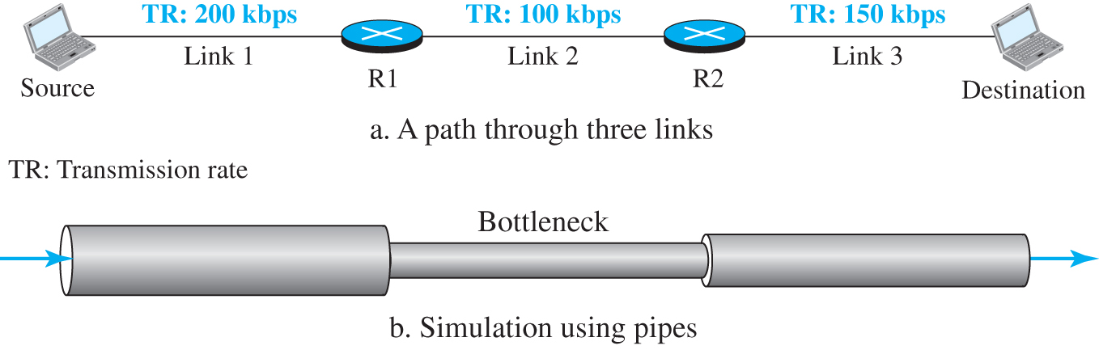
Figure 7.2 Throughput in a path with three links in a series
Access the text alternative for slide images.

Slide 24
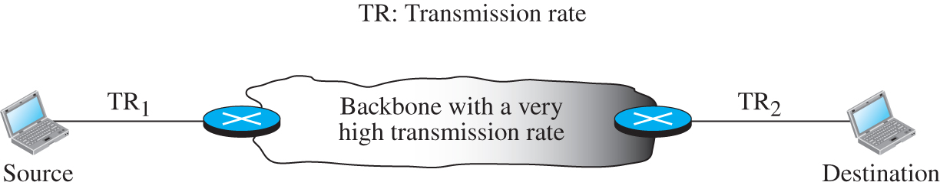
Figure 7.3 A path through the Internet backbone
Access the text alternative for slide images.

Slide 25
7.3.3 Packet Loss
Another issue that severely affects the performance of communication is the number of packets lost during transmission. When a router receives a packet while processing another packet, the received packet needs to be stored in the input buffer waiting for its turn. A router, however, has an input buffer with a limited size. A time may come when the buffer is full and the next packet needs to be dropped. The effect of packet loss on the Internet network layer is that the packet needs to be resent, which in turn may create overflow and cause more packet loss.

Slide 26
7.3.4 Congestion Control
Congestion control is a mechanism for improving performance. Although congestion at the network layer is not explicitly addressed in the Internet model, the study of congestion at this layer may help us to better understand the cause of congestion at the transport layer and find possible remedies to be used at the network layer. Congestion at the network layer is related to two issues, throughput and delay, which we discussed in the previous section.

Slide 27
7-4 INTERNET PROTOCOL VERSION 4
The network layer in the Internet has gone through several versions, but only two versions have survived: IP Version 4 (IPv4) and IP Version 6 (IPv6). Although IPv4 is almost depleted, we discuss it because there are still some areas that use this version and also because it is the foundation for IPv6.

Slide 28
7.4.1 IPv4 Addressing
The identifier used in the IP layer of the TCP/IP protocol suite to identify the connection of each device to the Internet is called the Internet address or IP address. An IPv4 address is a 32-bit address that uniquely and universally defines the connection of a host or a router to the Internet. The IP address is the address of the connection, not the host or the router, because if the device is moved to another network, the IP address may be changed.

Slide 29
Address Space 1
A protocol like IPv4 that defines addresses has an address space. An address space is the total number of addresses used by the protocol. If a protocol uses b bits to define an address, the address space is 2b because each bit can have two different values (0 or 1). IPv4 uses 32-bit addresses, which means that the address space is 232 or 4,294,967,296 (more than four billion). If there were no restrictions, more than 4 billion devices could be connected to the Internet.

Slide 30
Notation
There are three common notations to show an IPv4 address: binary notation (base 2), dotted-decimal notation (base 256), and hexadecimal notation (base 16).

Slide 31
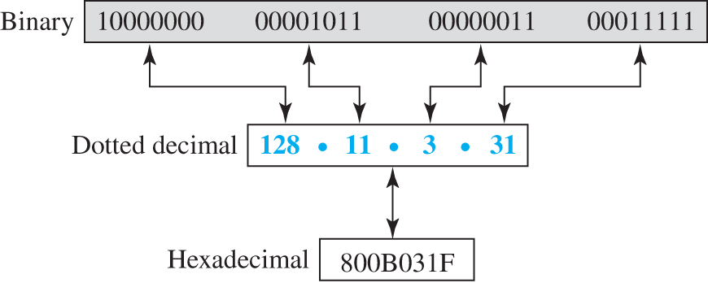
Figure 7.4 Three different notations in IPv4 addressing
Access the text alternative for slide images.

Slide 32
Hierarchy in Addressing
In any communication network that involves delivery, such as a telephone network or a postal network, the addressing system is hierarchical. A 32-bit IPv4 address is also hierarchical but divided only into two parts. The first part of the address, called the prefix, defines the network; the second part of the address, called the suffix, defines the node.

Slide 33
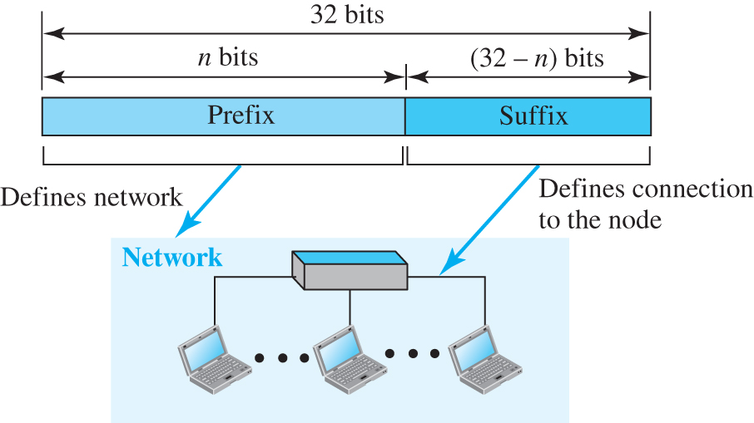
Figure 7.5 Hierarchy in addressing
Access the text alternative for slide images.

Slide 34
Classful Addressing
When the Internet started, an IPv4 address was designed with a fixed-length prefix, but to accommodate both small and large networks, three fixed-length prefixes were designed instead of one (n = 8, n = 16, and n = 24). The whole address space was divided into five classes (class A, B, C, D, and E), as shown in Figure 7.6. This scheme is referred to as classful addressing. Although classful addressing belongs to the past, it helps us to understand classless addressing, discussed later.

Slide 35
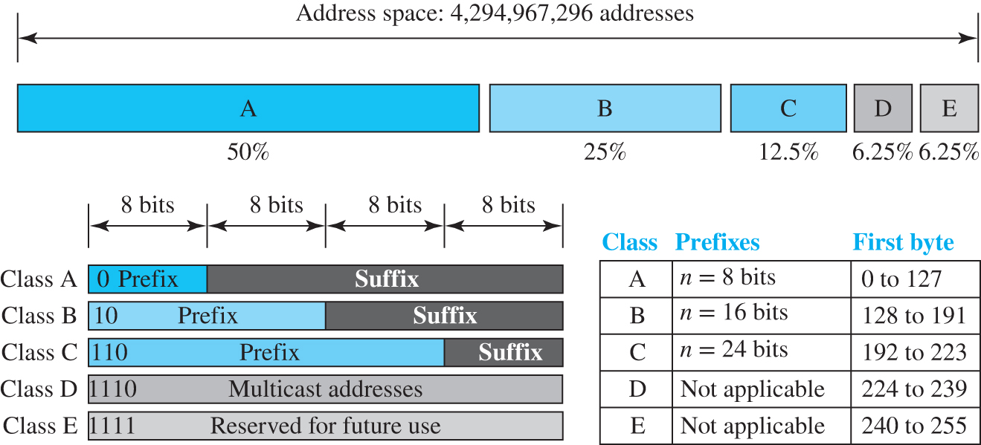
Figure 7.6 Occupation of the address space in classful addressing
Access the text alternative for slide images.

Slide 36
Classless Addressing
With the growth of the Internet, it was clear that a larger address space was needed as a long-term solution. The larger address space, however, requires that the length of IP addresses also be increased, which means the format of the IP packets needs to be changed. Although the long-range solution has already been devised and is called IPv6, a short-term solution was also devised to use the same address space but to change the distribution of addresses to provide a fair share to each organization. The short-term solution still uses IPv4 addresses, but it is called classless addressing.

Slide 37
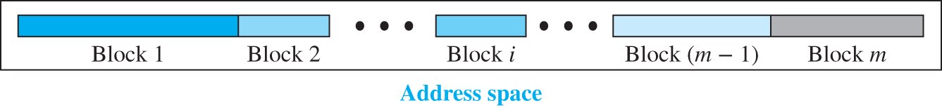
Figure 7.7 Variable-length blocks in classless addressing
Access the text alternative for slide images.

Slide 38
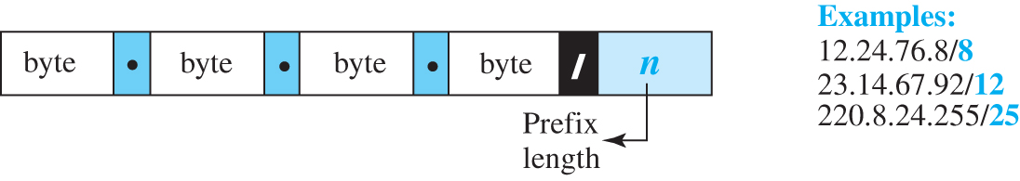
Figure 7.8 Slash notation (CIDR)
Access the text alternative for slide images.

Slide 39
Example 7.1
A classless address is given as 167.199.170.82/27. We can find the above three pieces of information as follows. The number of addresses in the network is
addresses. The first address can be found by keeping the first 27 bits and changing the rest of the bits to 0s.
Address: 167.199.170.82/27 | 10100111 | 11000111 | 10101010 | 01010010
First address: 167.199.170.64/27 | 10100111 | 11000111 | 10101010 | 01000000
The last address can be found by keeping the first 27 bits and changing the rest of the bits to 1s.
Address: 167.199.170.82/27 | 10100111 | 11000111 | 10101010 | 01011111
Last address: 167.199.170.95/27 | 10100111 | 11000111 | 10101010 | 01011111

Slide 40
Example 7.2
We repeat Example 7.1 using the mask. The mask in dotted-decimal notation is 256.256.256.224 The AND, OR, and NOT operations can be applied to individual bytes using calculators and applets at the book website.
Number of addresses in the block: | N = NOT (mask) + 1 = 0.0.0.31 + 1 = 32 addresses
First address: | First = (address) AND (mask) = 167.199.170. 82
Last address: | Last = (address) OR (NOT mask) = 167.199.170. 255

Slide 41
Example 7.3
In classless addressing, an address cannot per se define the block the address belongs to. For example, the address 230.8.24.56 can belong to many blocks. Some of them are shown below with the value of the prefix associated with that block.
Prefix length:16 | → | Block: | 230.8.0.0 | to | 230.8.255.255
Prefix length:20 | → | Block: | 230.8.16.0 | to | 230.8.31.255
Prefix length:26 | → | Block: | 230.8.24.0 | to | 230.8.24.63
Prefix length:27 | → | Block: | 230.8.24.32 | to | 230.8.24.63
Prefix length:29 | → | Block: | 230.8.24.56 | to | 230.8.24.63
Prefix length:31 | → | Block: | 230.8.24.56 | to | 230.8.24.57

Slide 42
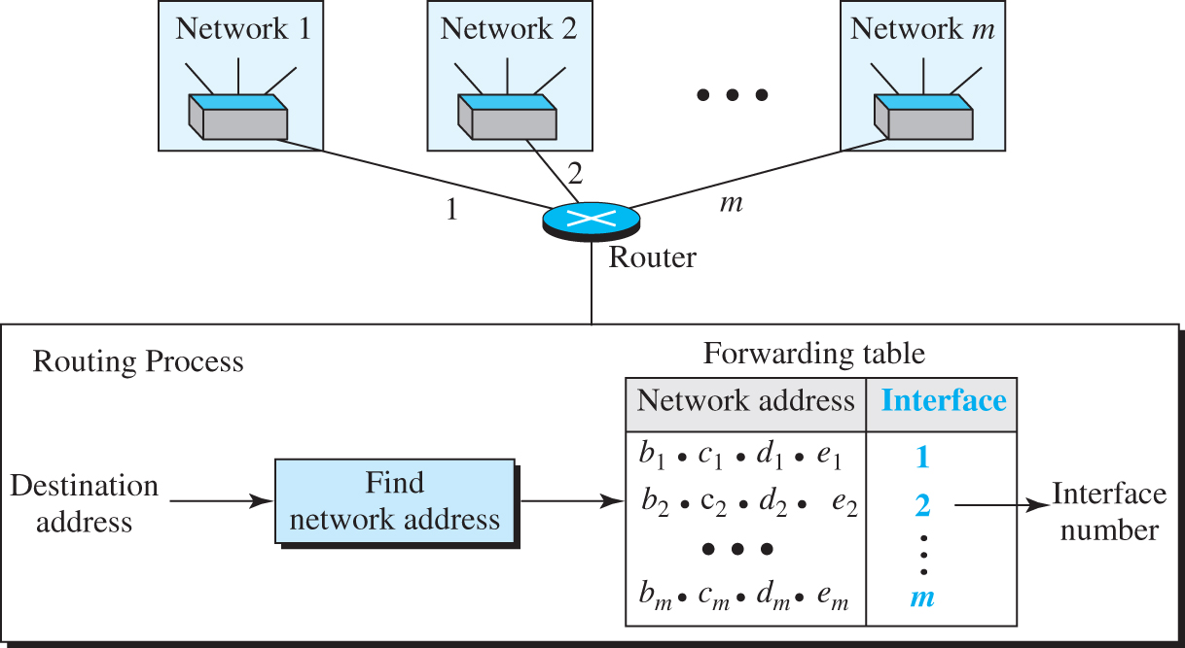
Figure 7.9 Network address
Access the text alternative for slide images.

Slide 43
Example 7.4
An ISP has requested a block of 1000 addresses. Since 1000 is not a power of 2, 1024 addresses are granted. The prefix length is calculated as
An available block, 18.14.12.0/22, is granted to the ISP. It can be seen that the first address in decimal is 302,910,464, which is divisible by 1024.

Slide 44
Example 7.5 (1)
An organization is granted a block of addresses with the beginning address 14.24.74.0/24. The organization needs to have 3 subblocks of addresses to use in its three subnets: one subblock of 10 addresses, one subblock of 60 addresses, and one subblock of 120 addresses. Design the subblocks.
Solution
There are
addresses in this block. The first address is 14.24.74.0/24; the last address is 14.24.74.255/24. To satisfy the third requirement, we assign addresses to subblocks, starting with the largest and ending with the smallest one.

Slide 45
Example 7.5 (2)
The number of addresses in the largest subblock, which requires 120 addresses, is not a power of 2. We allocate 128 addresses. The subnet mask for this subnet can be found as
The first address in this block is 14.24.74.0/25; the last address is 14.24.74.127/25.
The number of addresses in the second largest subblock, which requires 60 addresses, is not a power of 2 either. We allocate 64 addresses. The subnet mask for this subnet can be found as
The first address in this block is 14.24.74.128/26; the last address is 14.24.74.191/26.

Slide 46
Example 7.5 (3)
The number of addresses in the largest subblock, which requires 120 addresses, is not a power of 2. We allocate 128 addresses. The subnet mask for this subnet can be found as
The first address in this block is 14.24.74.0/25; the last address is 14.24.74.127/25.
If we add all addresses in the previous subblocks, the result is 208 addresses, which means 48 addresses are left in reserve. The first address in this range is 14.24.74.208. The last address is 14.24.74.255. We don’t know about the prefix length yet. Figure 4.36 shows the configuration of blocks. We have shown the first address in each block.

Slide 47
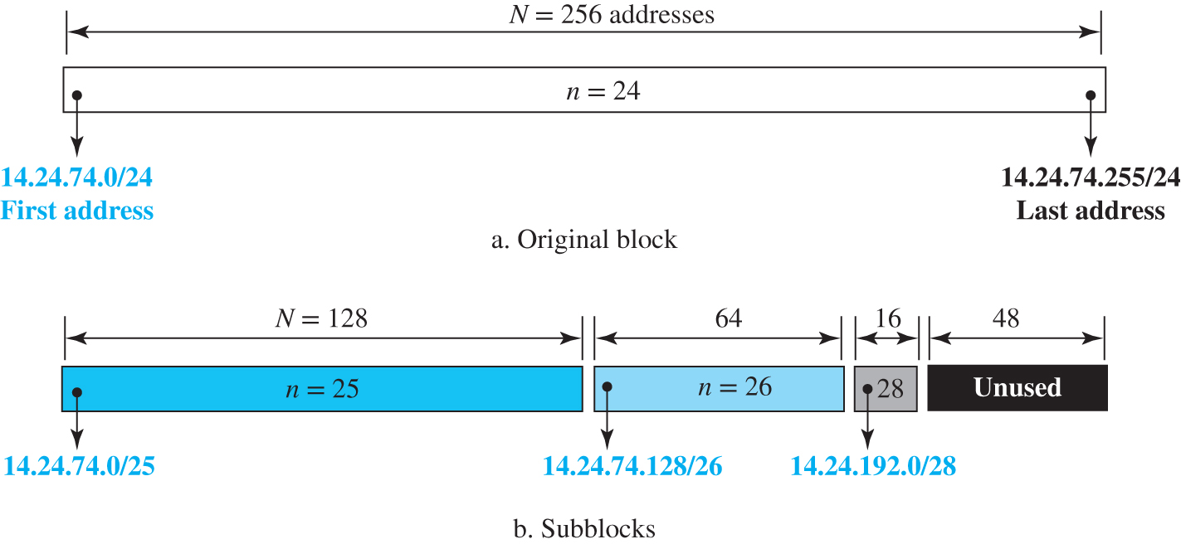
Figure 7.10 Solution to Example 4.5
Access the text alternative for slide images.

Slide 48
Example 7.6
Figure 7.11 shows how four small blocks of addresses are assigned to four organizations by an ISP. The ISP combines these four blocks into one single block and advertises the larger block to the rest of the world. Any packet destined for this larger block should be sent to this ISP. It is the responsibility of the ISP to forward the packet to the appropriate organization. This is similar to routing we can find in a postal network. All packages coming from outside a country are sent first to the capital and then distributed to the corresponding destination.

Slide 49
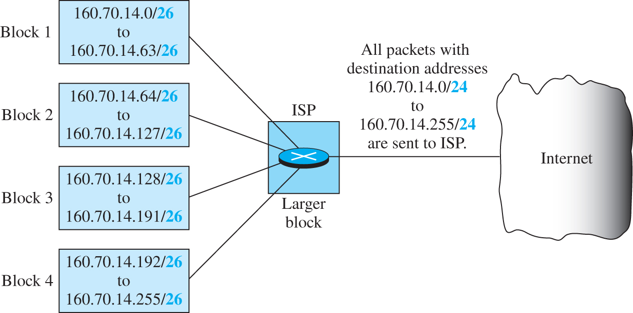
Figure 7.11 Example of address aggregation
Access the text alternative for slide images.

Slide 50
7.4.2 Four Related Protocols
The network layer in version 4 can be thought of as one main protocol and three auxiliary ones. The main protocol, IPv4, is responsible for packetizing, forwarding, and delivery of a packet. The ICMPv4 helps IPv4 to handle some errors that may occur in delivery. The IGMP is used to help IPv4 in multicasting. ARP is used in address mapping.

Slide 51
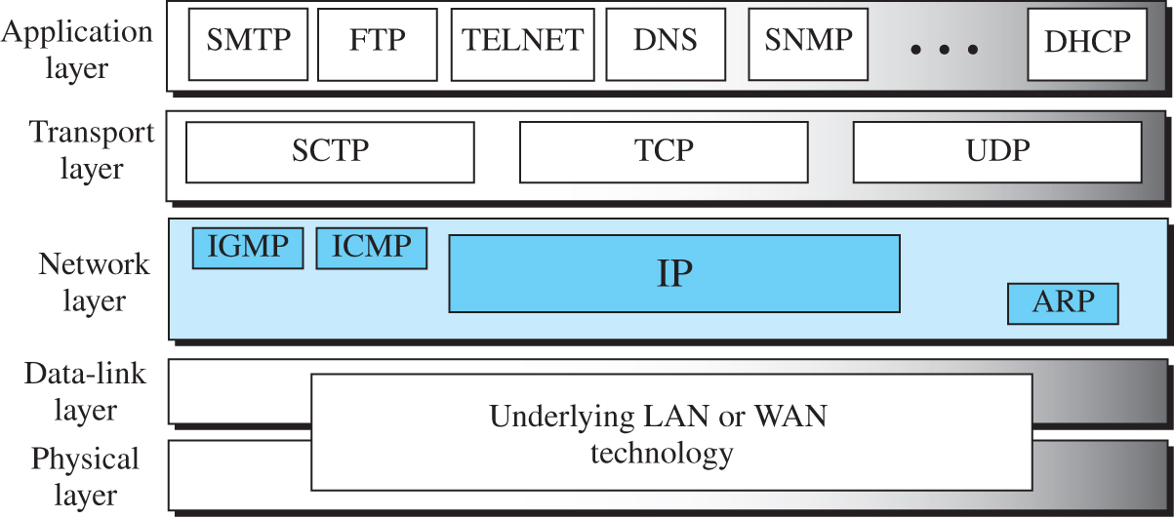
Figure 7.12 Position of IP and other network-layer protocols in TCP/IP protocol suite
Access the text alternative for slide images.

Slide 52
Datagram Format
Packets used by the IP are called datagrams. Figure 7.13 shows the IPv4 datagram format. A datagram is a variable-length packet consisting of two parts: header and payload (data). The header is 20 to 60 bytes in length and contains information essential to routing and delivery. It is customary in TCP/IP to show the header in 4-byte sections.

Slide 53
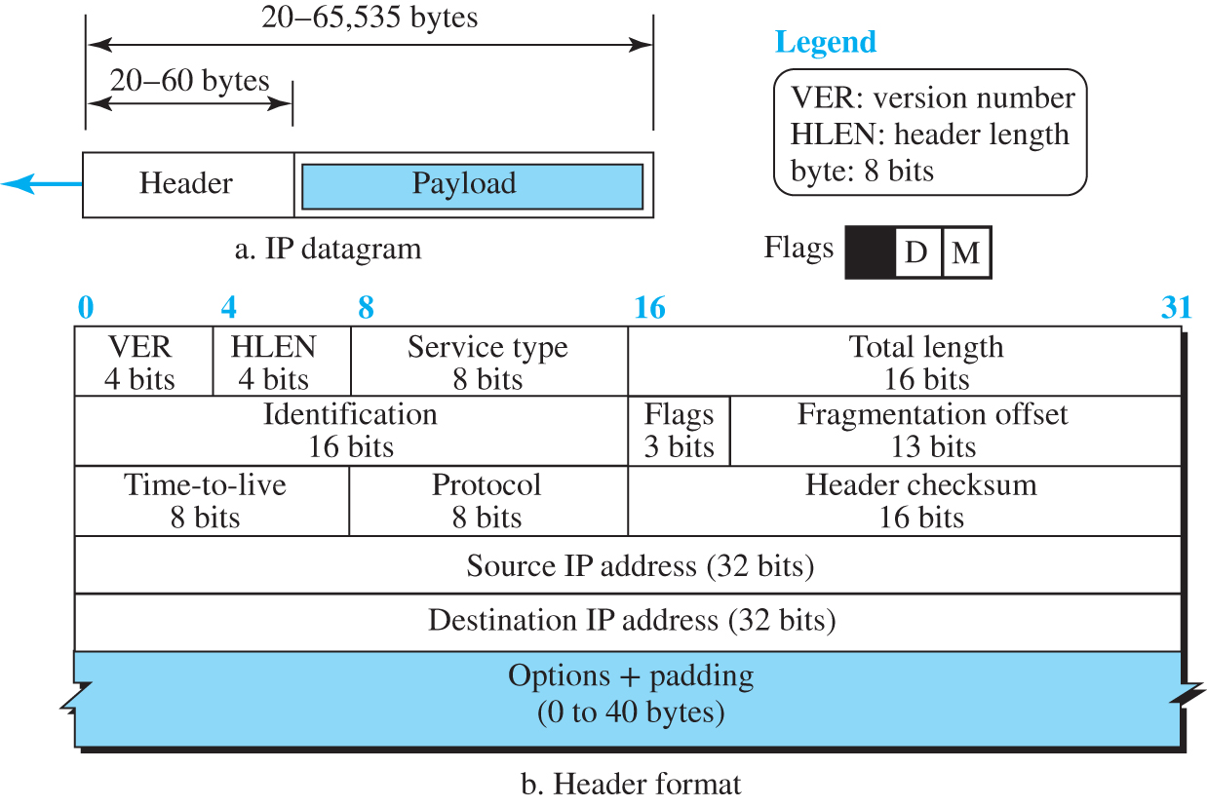
Figure 7.13 IP datagram
Access the text alternative for slide images.

Slide 54
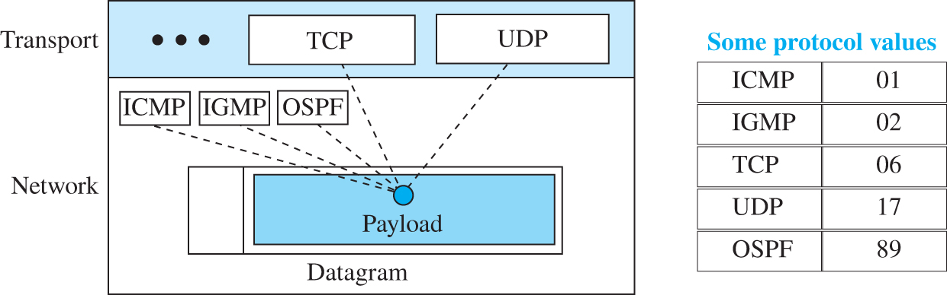
Figure 7.14 Multiplexing and demultiplexing using the value of the protocol field
Access the text alternative for slide images.

Slide 55
Example 7.7
The receiver discards the packet. Why?
An IPv4 packet has arrived with the first 8 bits as
Solution
There is an error in this packet. The 4 leftmost bits (0100)2 show the version, which is correct. The next 4 bits (0010)2 show an invalid header length (2 * 4 = 8). The minimum number of bytes in the header must be 20. The packet has been corrupted in transmission.

Slide 56
Example 7.8
In an IPv4 packet, the value of HLEN is
How many bytes of options are being carried by this packet?
Solution
The HLEN value is 8, which means the total number of bytes in the header is 8 * 4, or 32 bytes. The first 20 bytes are the base header, the next 12 bytes are the options.

Slide 57
Example 7.9
In an IPv4 packet, the value of HLEN is 5, and the value of the total length field is
How many bytes of data are being carried by this packet?
Solution
The HLEN value is 5, which means the total number of bytes in the header is 5 * 4, or 20 bytes (no options). The total length is
or 40 bytes, which means the packet is carrying 20 bytes of data (40 - 20).

Slide 58
Example 7.10
An IPv4 packet has arrived with the first few hexadecimal digits as shown
How many hops can this packet travel before being dropped? The data belong to what upper-layer protocol?
Solution
To find the time-to-live field, we skip 8 bytes (16 hexadecimal digits). The time-to-live field is the ninth byte, which is
This means the packet can travel only one hop. The protocol field is the next byte
which means that the upper-layer protocol is IGMP.

Slide 59
Example 7.11
Figure 7.15 shows an example of a checksum calculation for an IPv4 header without options. The header is divided into 16-bit sections. All the sections are added and the sum is complemented after wrapping the leftmost digit. The result is inserted in the checksum field.

Slide 60
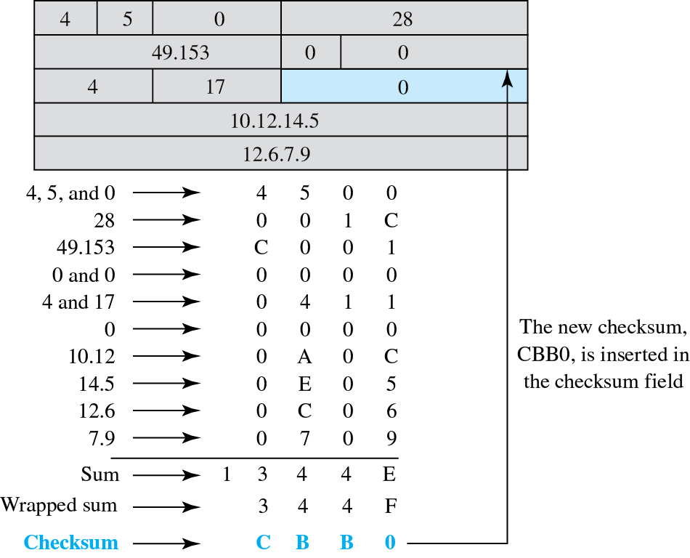
Figure 7.15 Example of checksum calculation
Access the text alternative for slide images.

Slide 61
Fragmentation
A datagram can travel through different networks. Each router decapsulates the IP datagram from the frame it receives, processes it, and then encapsulates it in another frame. The format and size of the received frame depend on the protocol used by the physical network through which the frame has just traveled. The format and size of the sent frame depend on the protocol used by the physical network through which the frame is going to travel. For example, if a router connects a LAN to a WAN, it receives a frame in the LAN format and sends a frame in the WAN format.

Slide 62
Maximum Transfer Unit
Each link-layer protocol has its own frame format. One of the features of each format is the maximum size of the payload that can be encapsulated in a frame, total size of the datagram must be less than the maximum size (see Figure 7.16).

Slide 63
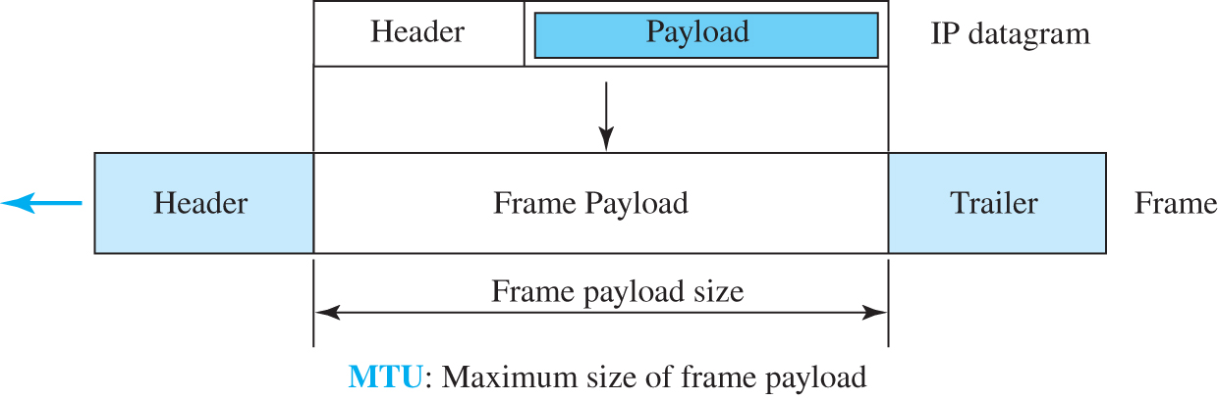
Figure 7.16 Maximum transfer unit (MTU)
Access the text alternative for slide images.

Slide 64
Fields Related to Fragmentation
We mentioned before that three fields in an IP datagram are related to fragmentation: identification, flags, and fragmentation offset.
The 16-bit identification field identifies a datagram originating from the source host.
The 3-bit flags field defines three flags.
The 13-bit fragmentation offset field shows the relative position of this fragment with respect to the whole datagram.

Slide 65
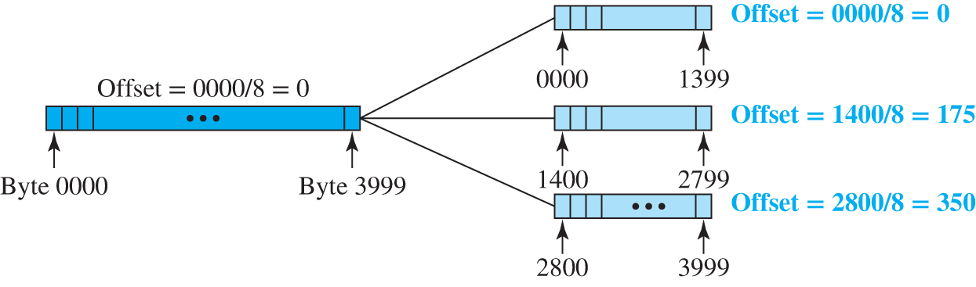
Figure 7.17 Fragmentation example
Access the text alternative for slide images.

Slide 66
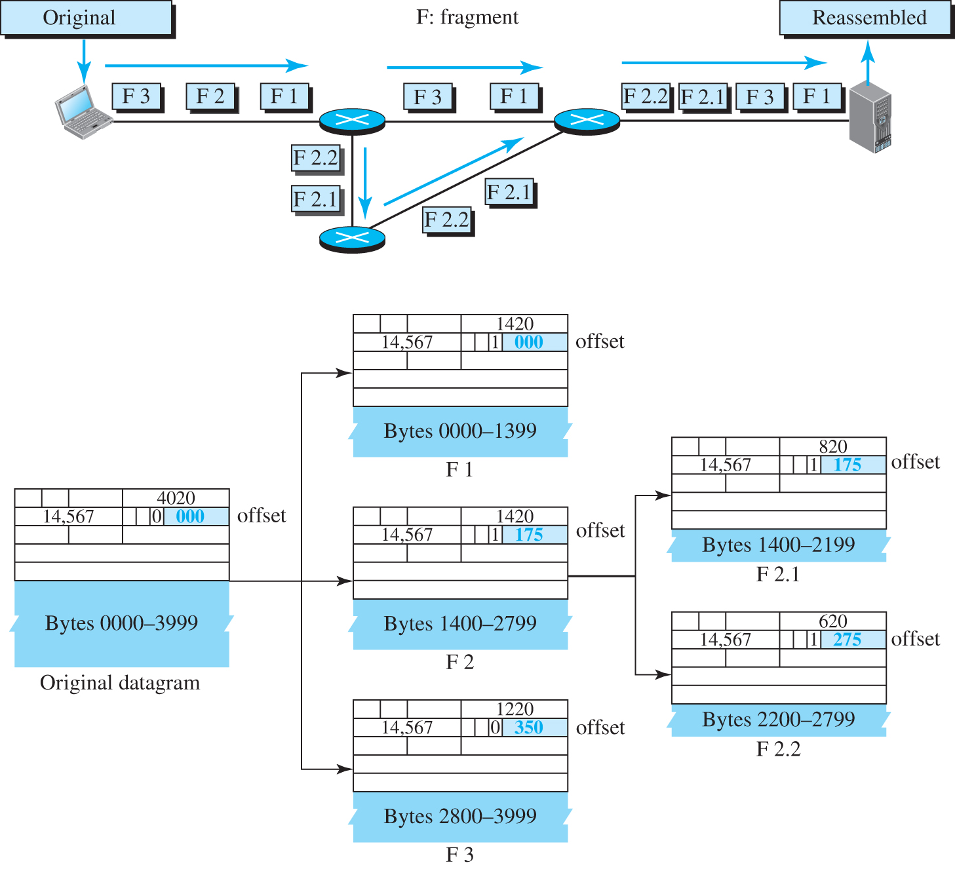
Figure 7.18 Detailed fragmentation example
Access the text alternative for slide images.

Slide 67
Example 7.12
A packet has arrived with an M bit value of 0. Is this the first fragment, the last fragment, or a middle fragment? Do we know if the packet was fragmented?
Solution
If the M bit is 0, it means that there are no more fragments; the fragment is the last one. However, we cannot say if the original packet was fragmented or not. A non-fragmented packet is considered the last fragment.

Slide 68
Example 7.13
A packet has arrived with an M bit value of 1. Is this the first fragment, the last fragment, or a middle fragment? Do we know if the packet was fragmented?
Solution
If the M bit is 1, it means that there is at least one more fragment. This fragment can be the first one or a middle one, but not the last one. We don’t know if it is the first one or a middle one; we need more information (the value of the fragmentation offset).

Slide 69
Example 7.14
A packet has arrived with an M bit value of 1 and a fragmentation offset value of 0. Is this the first fragment, the last fragment, or a middle fragment?
Solution
Because the M bit is 1, it is either the first fragment or a middle one. Because the offset value is 0, it is the first fragment.

Slide 70
Example 7.15
A packet has arrived in which the offset value is 100. What is the number of the first byte? Do we know the number of the last byte?
Solution
To find the number of the first byte, we multiply the offset value by 8. This means that the first byte number is 800. We cannot determine the number of the last byte unless we know the length of the data.

Slide 71
Example 7.16
A packet has arrived in which the offset value is 100, the value of HLEN is 5, and the value of the total length field is 100. What are the numbers of the first byte and the last byte?
Solution
The first byte number is 100 * 8 = 800. The total length is 100 bytes, and the header length is 20 bytes (5 * 4), which means that there are 80 bytes in this datagram. If the first byte number is 800, the last byte number must be 879.

Slide 72
7.4.3 Options
The header of the IPv4 datagram is made of two parts: a fixed part and a variable part. The fixed part is 20 bytes long and was discussed in the previous section. The variable part comprises the options that can be a maximum of 40 bytes (in multiples of 4 bytes) to preserve the boundary of the header.

Slide 73
Single-Byte Options
There are two single-byte options.
No Operation
A no-operation option is a 1-byte option used as a filler between options.
End of Option
An end-of-option option is a 1-byte option used for padding at the end of the option field. It, however, can only be used as the last option.

Slide 74
Security of IPv4 Datagrams
We give a brief idea about the security issues in IP protocol.
Packet Sniffing
An intruder may intercept an IP packet and make a copy of it.
Packet Modification
The attacker intercepts the packet, changes its contents, and sends the new packet to the receiver..
IP Spoofing
An attacker can masquerade as somebody else and create an IP packet that carries the source address of another computer.

Slide 75
IPSec
The IP packets today can be protected from the previously mentioned attacks using a protocol called IPSec (IP Security). This protocol, which is used in conjunction with the IP protocol, creates a connection-oriented service between two entities in which they can exchange IP packets without worrying about the three attacks discussed above. We will discuss IPSec in detail in Chapter 13.

Slide 76
7.4.4 ICMPv4
The IPv4 has no error-reporting or error-correcting mechanism. The IP protocol also lacks a mechanism for host and management queries. The Internet Control Message Protocol version 4 (ICMPv4) has been designed to compensate for the above two deficiencies.

Slide 77
Messages
ICMP messages are divided into two broad categories: error-reporting messages and query messages. The error-reporting messages report problems that a router or a host (destination) may encounter when it processes an IP packet. The query messages, which occur in pairs, help a host or a network manager get specific information from a router or another host. For example, nodes can discover their neighbors. Also, hosts can discover and learn about routers on their network and routers can help a node redirect its messages.

Slide 78
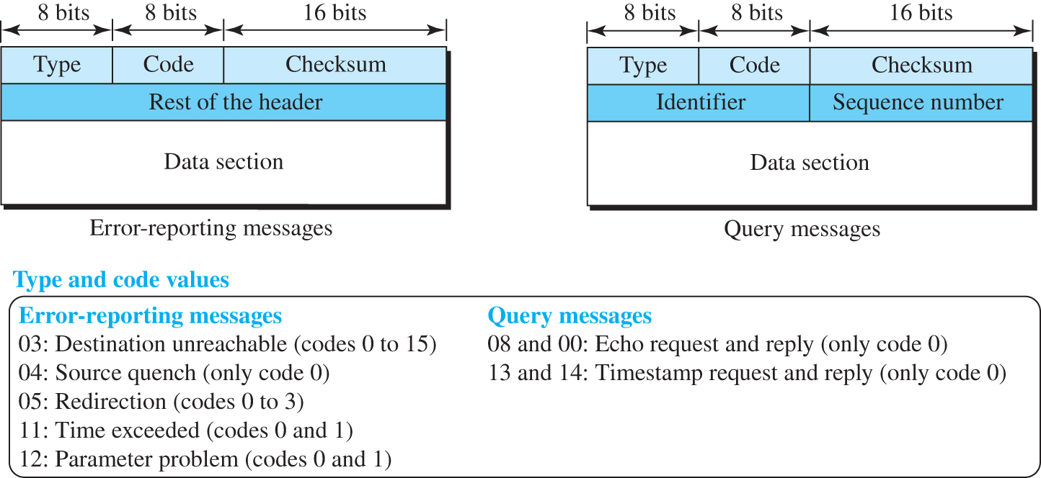
Figure 7.19 General format of ICMP messages
Access the text alternative for slide images.

Slide 79
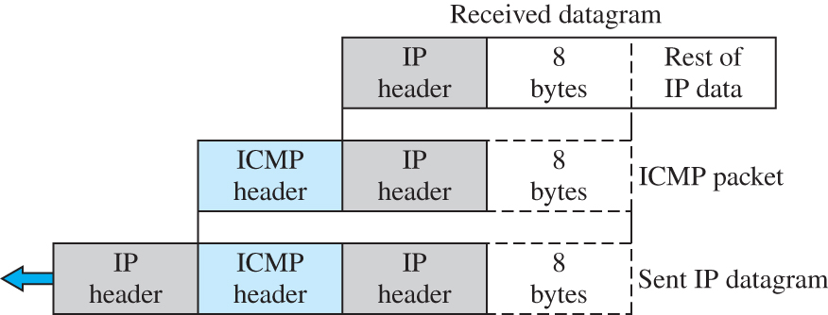
Figure 7.20 Contents of data field for error messages
Access the text alternative for slide images.

Slide 80
Deprecated Messages
Three pairs of messages are declared obsolete by IETF:
Information request and replay messages
Address mask request and reply messages
Router solicitation and advertisement messages

Slide 81
Debugging Tools
There are several tools that can be used in the Internet for debugging. We can determine the viability of a host or router. We can trace the route of a packet. We introduce two tools that use ICMP for debugging: ping and traceroute.

Slide 82
Ping
We can use the ping program to find if a host is alive and is responding.

Slide 83
Example 7.17
The following shows how we send a ping message to the auniversity.edu site.
$ ping auniversity.edu
PING auniversity.edu (152.181.8.3) 56 (84) bytes of data. | ttl=62 | time=1.91 ms
64 bytes from auniversity.edu (152.181.8.3): icmp_seq=0 | ttl=62 | time=2.04 ms
64 bytes from auniversity.edu (152.181.8.3): icmp_seq=1 | ttl=62 | time=1.90 ms
64 bytes from auniversity.edu (152.181.8.3): icmp_seq=2 | ttl=62 | time=1.90 ms
64 bytes from auniversity.edu (152.181.8.3): icmp_seq=3 | ttl=62 | time=1.97 ms
64 bytes from auniversity.edu (152.181.8.3): icmp_seq=4 | ttl=62 | time=1.93 ms
64 bytes from auniversity.edu (152.181.8.3): icmp_seq=5 | ttl=62 | time=2.00 ms
--- auniversity.edu statistics ---
6 packets transmitted, 6 received, 0% packet loss
rtt min/avg/max = 1.90/1.95/2.04 ms

Slide 84
Traceroute or Tracert
The traceroute program in UNIX or tracert in Windows can be used to trace the path of a packet from a source to the destination. It can find the IP addresses of all the routers that are visited along the path. The program is usually set to check for the maximum of 30 hops (routers) to be visited. The number of hops in the Internet is normally less than this. Since these two programs behave different in Unix and Windows, we explain them separately.

Slide 85
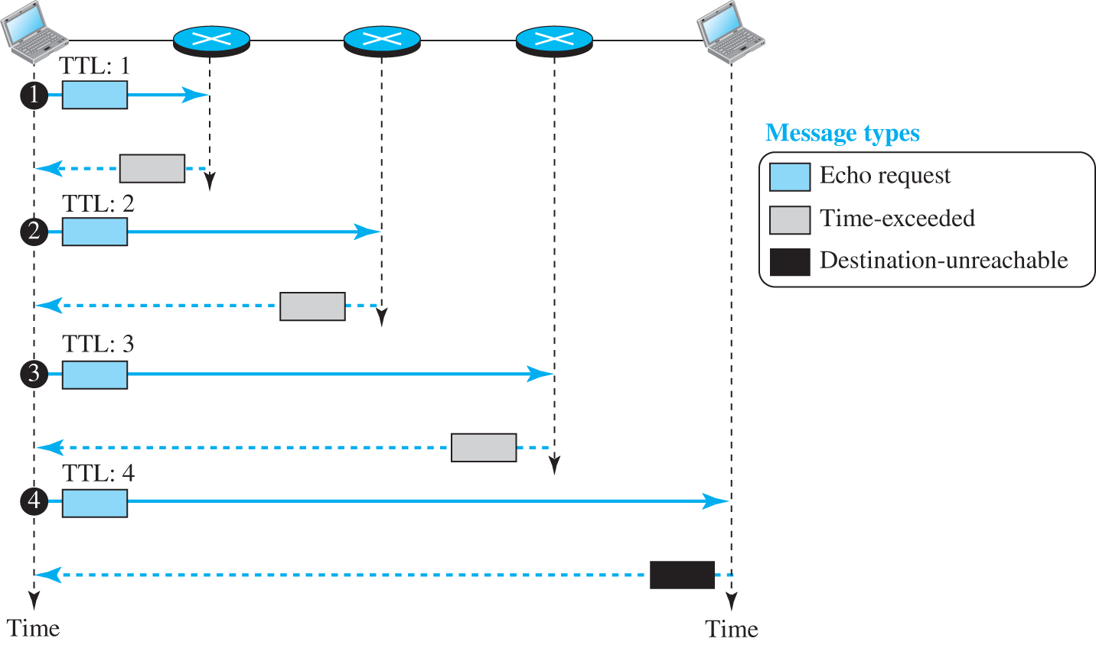
Figure 7.21 Example of traceroute program
Access the text alternative for slide images.

Slide 86
ICMP Checksum
In ICMP, the checksum is calculated over the entire message (header and data).

Slide 87
Example 7.18
Figure 7.22 shows an example of checksum calculation for a simple echo-request message. We randomly chose the identifier to be 1 and the sequence number to be 9. The message is divided into 16-bit (2-byte) words. The words are added and the sum is complemented. Now the sender can put this value in the checksum field.

Slide 88
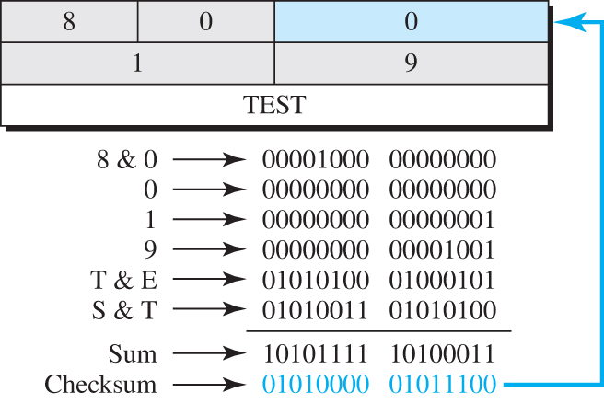
Figure 7.22 Example of checksum calculation
Access the text alternative for slide images.

Slide 89
7.4.5 Mobile IP
In the last section of this chapter, we discuss mobile IP. As mobile and personal computers such as notebooks become increasingly popular, we need to think about mobile IP, the extension of IP protocol that allows mobile computers to be connected to the Internet at any location where the connection is possible. In this section, we discuss this issue.

Slide 90
Addressing
The main problem that must be solved in providing mobile communication using the IP protocol is addressing.

Slide 91
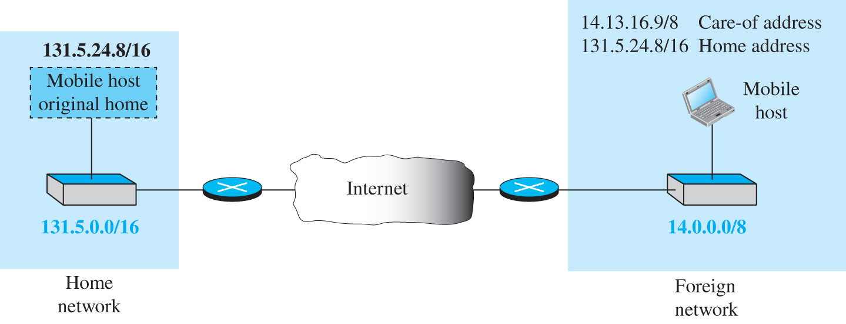
Figure 7.23 Home address and care-of address
Access the text alternative for slide images.

Slide 92
Agents
To make the change of address transparent to the rest of the Internet requires a home agent and a foreign agent. Figure 7.24 shows the position of a home agent relative to the home network and a foreign agent relative to the foreign network.

Slide 93
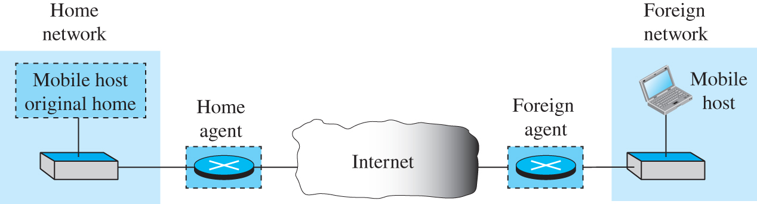
Figure 7.24 Home agent and foreign agent
Access the text alternative for slide images.

Slide 94
Three Phases
To communicate with a remote host, a mobile host goes through three phases: agent discovery, registration, and data transfer, as shown in Figure 7.25.

Slide 95
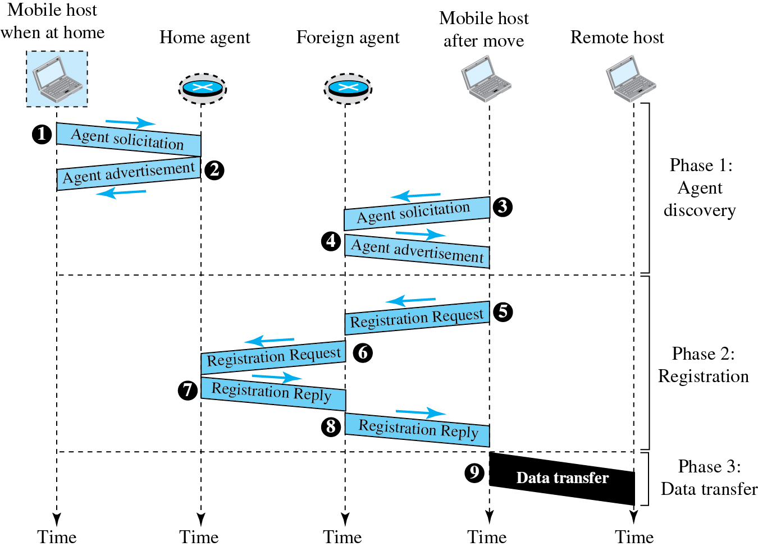
Figure 7.25 Remote host and mobile host communication
Access the text alternative for slide images.

Slide 96
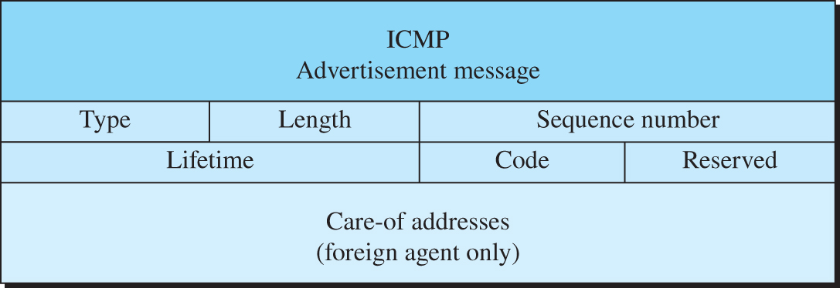
Figure 7.26 Agent advertisement
Access the text alternative for slide images.

Slide 97
Table 7.1 Code Bits
Bit | Meaning
0 | Registration required. No collocated care-of address.
1 | Agent is busy and does not accept registration at this moment.
2 | Agent acts as a home agent.
3 | Agent acts as a foreign agent.
4 | Agent uses minimal encapsulation.
5 | Agent uses generic routing encapsulation (GRE).
6 | Agent uses generic routing encapsulation (GRE).
7 | Unused (0).

Slide 98
Registration
The second phase in mobile communication is registration. After a mobile host has moved to a foreign network and discovered the foreign agent, it must register. There are four aspects of registration:
The mobile host must register itself with the foreign agent.
The mobile host must register itself with its home agent.
The mobile host must renew registration if it has expired.
The mobile host must cancel its registration when it returns.

Slide 99
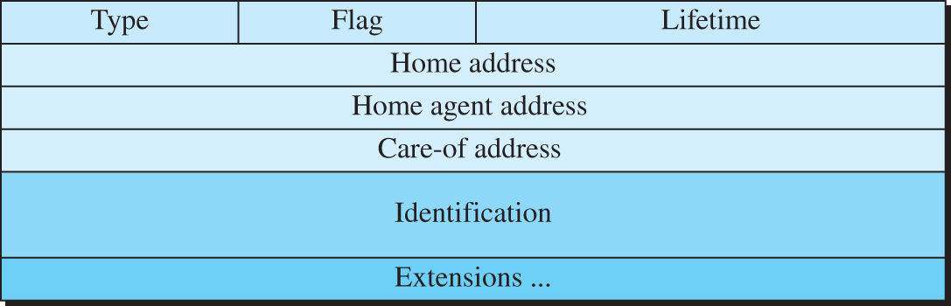
Figure 7.27 Registration request format
Access the text alternative for slide images.

Slide 100
Table 7.2 Registration request flag field bits
Bit | Meaning
0 | Mobile host requests that home agent retain its prior care-of address.
1 | Mobile host requests that home agent tunnel any broadcast message.
2 | Mobile host is using collocated care-of address.
3 | Mobile host requests that home agent use minimal encapsulation.
4 | Mobile host requests generic routing encapsulation (GRE).
5 | Mobile host requests header compression.
6 –7 | Reserved bits.

Slide 101
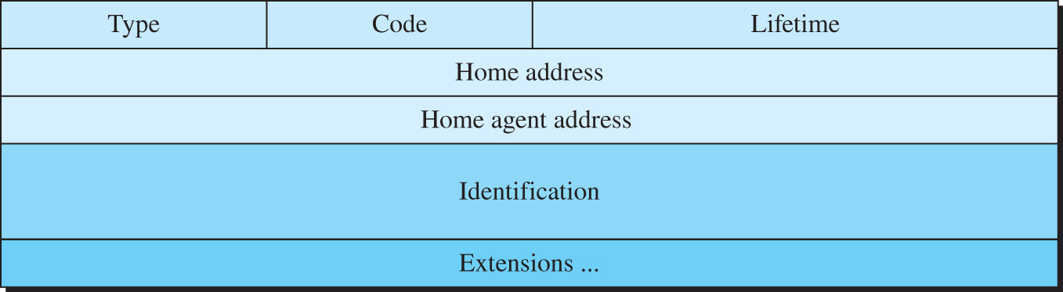
Figure 7.28 Registration reply format
Access the text alternative for slide images.

Slide 102
Data Transfer
After agent discovery and registration, a mobile host can communicate with a remote host. Figure 7.29 shows the idea.

Slide 103
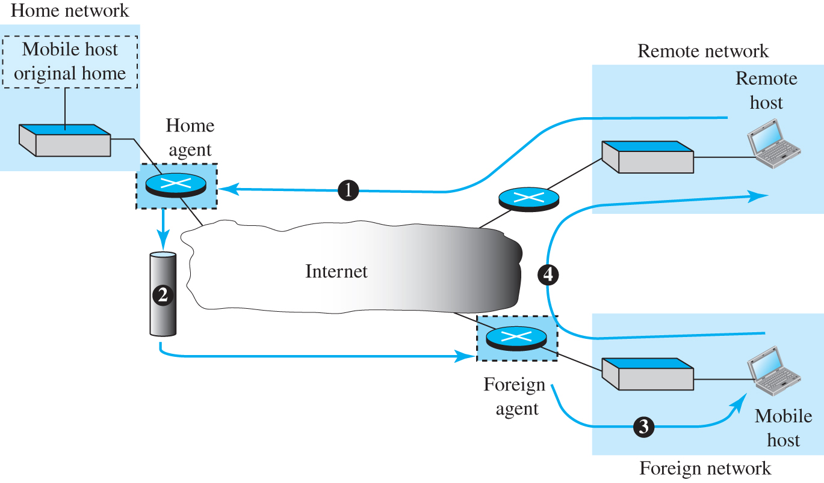
Figure 7.29 Data transfer
Access the text alternative for slide images.

Slide 104
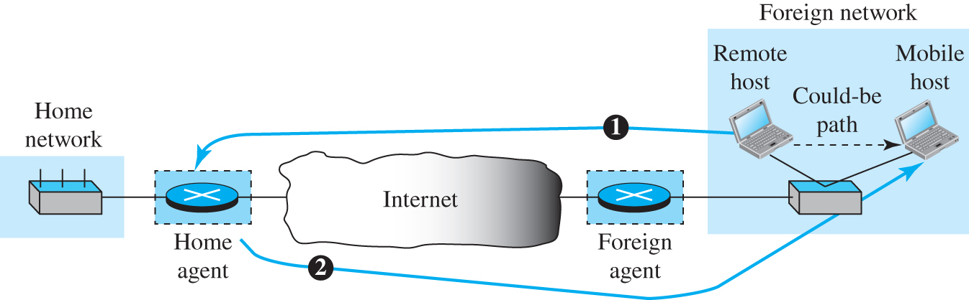
Figure 7.30 Double crossing
Access the text alternative for slide images.

Slide 105
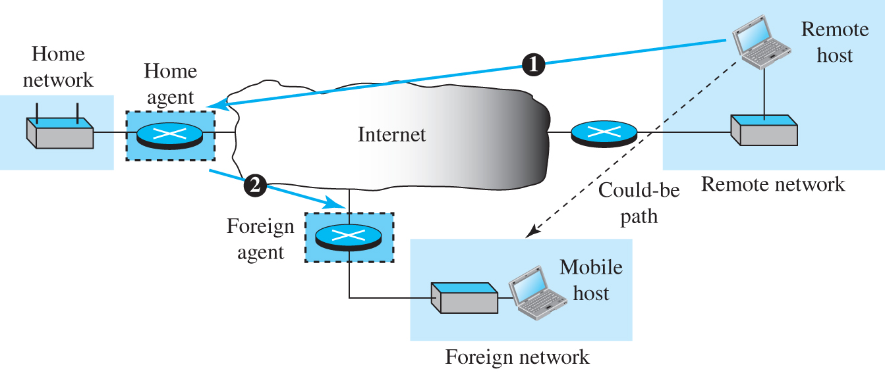
Figure 7.31 Triangle routing
Access the text alternative for slide images.

Slide 106
7.4.6 Forwarding of IP Packets
We discussed the concept of forwarding at the network layer earlier in this chapter. In this section, we extend the concept to include the role of IP addresses in forwarding. As we discussed before, forwarding means to place the packet in its route to its destination. Since the Internet today is made of a combination of links (networks), forwarding means to deliver the packet to the next hop (which can be the final destination or the intermediate connecting device). Although the IP protocol was originally designed as a connectionless protocol, today the tendency is to change it to connection-oriented protocol. We discuss both cases.

Slide 107
Forwarding Based on Destination Address
We first discuss forwarding based on the destination address. This is a traditional approach, which is prevalent today. In this case, forwarding requires a host or a router to have a forwarding table. When a host has a packet to send or when a router has received a packet to be forwarded, it looks at this table to find the next hop to deliver the packet to.

Slide 108
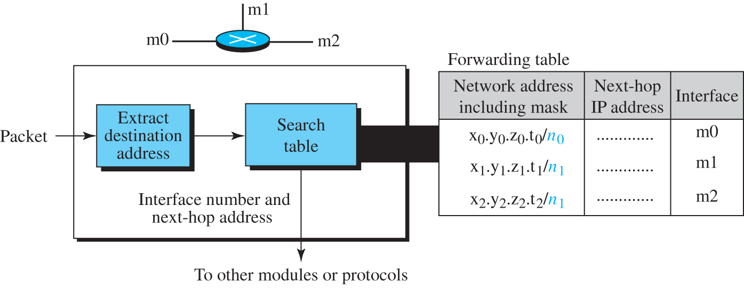
Figure 7.32 Simplified forwarding module in classless address
Access the text alternative for slide images.

Slide 109
Example 7.19
Make a forwarding table for router R1 using the configuration in Figure 7.33.

Slide 110
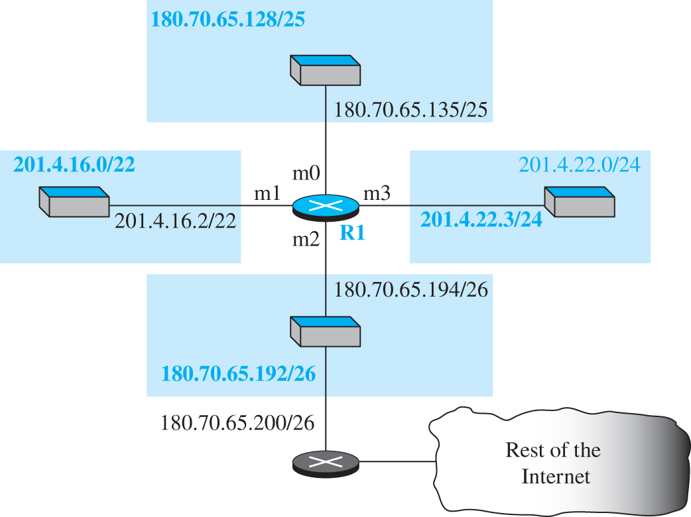
Figure 7.33 Configuration for Example 7.19
Access the text alternative for slide images.

Slide 111
Table 7.3 Forwarding table for router R1
Network address/mask | Next hop | Interface
180.70.65.192/26 | — | m2
180.70.65.128/25 | — | m0
201.4.22.0/24 | — | m3
201.4.16.0/22 | — | m1
Default | 180.70.65.200 | m2

Slide 112
Example 7.20
Instead of Table 7.3, we can use Table 7.4, in which the network address/mask is given in bits.

Slide 113
Table 7.4 Forwarding table for router R1 using prefix bit
Leftmost bits in the destination address | Next hop | Interface
10110100 01000110 01000001 11 | — | m2
10110100 01000110 01000001 1 | — | m0
11001001 00000100 00011100 | — | m3
11001001 00000100 000100 | — | m1
Default | 180.70.65.200 | m2

Slide 114
Example 7.21
The router performs the following steps
The first mask (/26) is applied to the destination address. The result is 180.70.65.128, which does not match the corresponding network address.
The second mask (/25) is applied to the destination address. The result is 180.70.65.128, which matches the corresponding network address. The next-hop address and the interface number m0 are extracted for forwarding the packet.

Slide 115
Address Aggregation
When we use classful addressing, there is only one entry in the forwarding table for each site outside the organization. The entry defines the site even if that site is subnetted. When a packet arrives at the router, the router checks the corresponding entry and forwards the packet accordingly. When we use classless addressing, it is likely that the number of forwarding table entries will increase. To alleviate the problem, the idea of address aggregation was designed. In Figure 7.34 we have two routers.

Slide 116
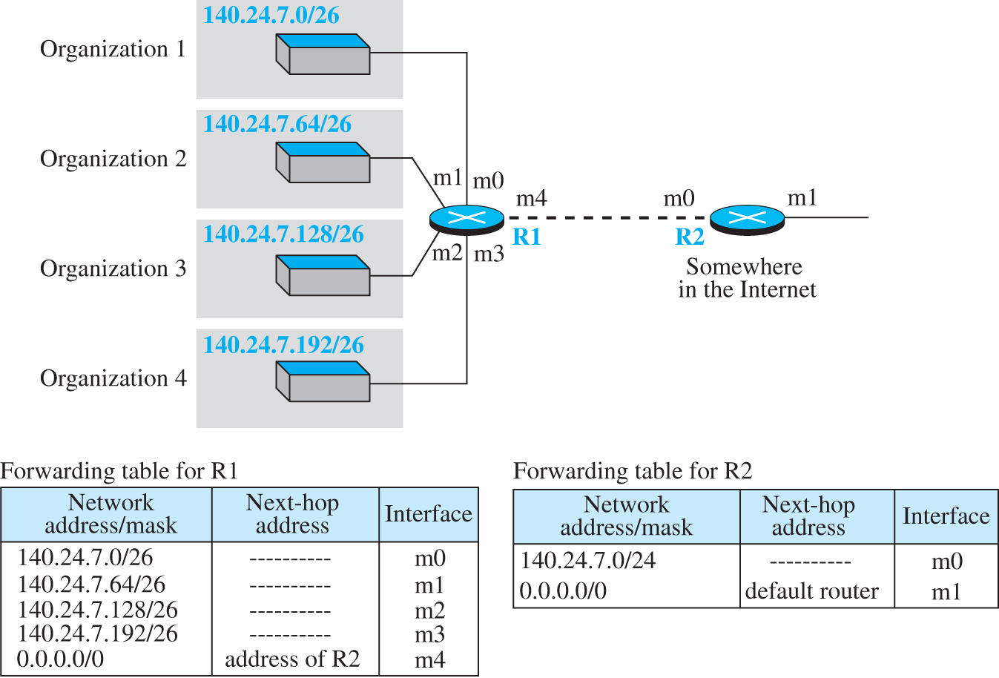
Figure 7.34 Address aggregation
Access the text alternative for slide images.

Slide 117
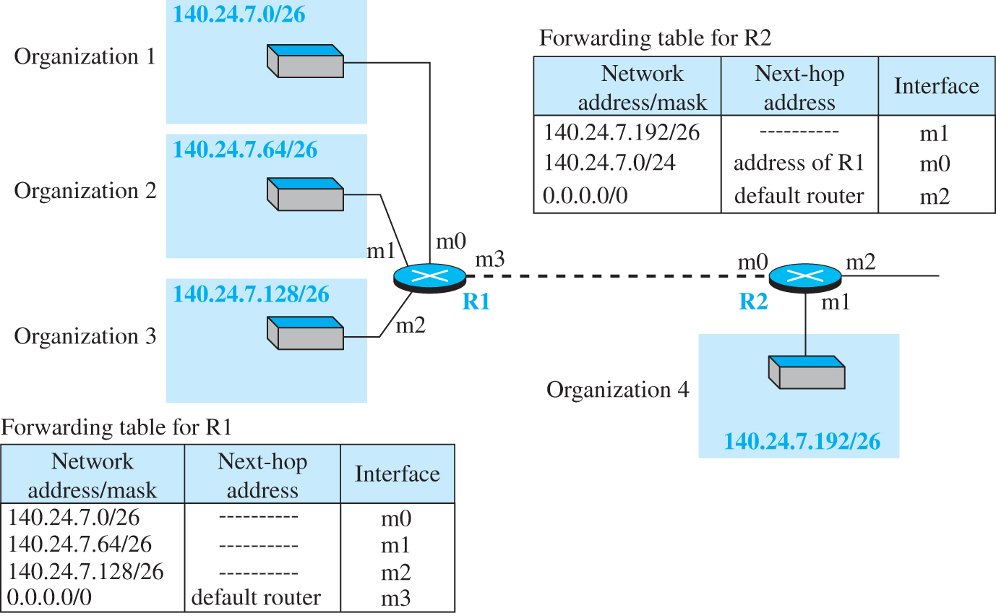
Figure 7.35 Longest mask addressing
Access the text alternative for slide images.

Slide 118
Example 7.22
As an example of hierarchical routing, let us consider . A regional ISP is granted 16,384 addresses starting from 120.14.64.0. The regional ISP has decided to divide this block into 4 subblocks, each with 4096 addresses. Three of these subblocks are assigned to three local ISPs, the second subblock is reserved for future use. Note that the mask for each block is /20 because the original block with mask /18 is divided into 4 blocks.

Slide 119
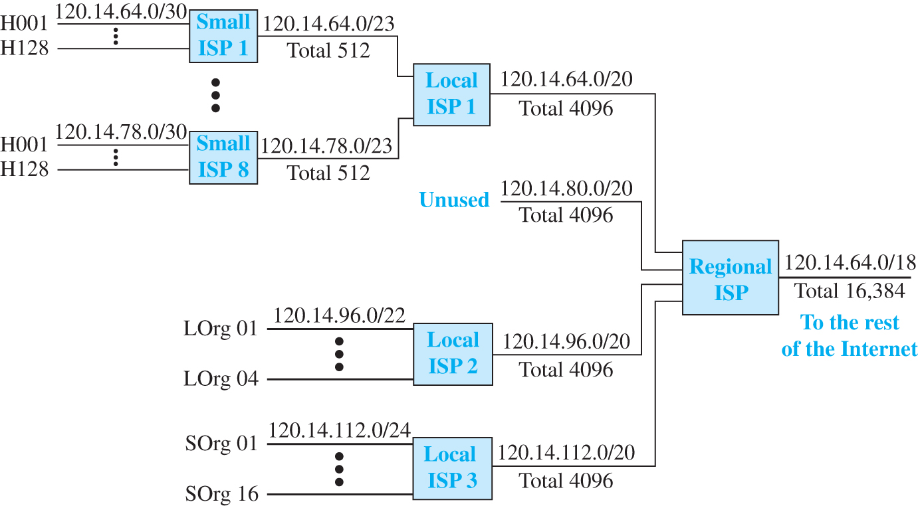
Figure 7.36 Hierarchical routing with ISPs
Access the text alternative for slide images.

Slide 120
Forwarding Table Search Algorithm
In classless addressing, there is no network information in the destination address. The simplest, but not the most efficient, search method is called the longest prefix match (as we discussed before). The forwarding table can be divided into buckets, one for each prefix. The router first tries the longest prefix. If the destination address is found in this bucket, the search is complete. If the address is not found, the next prefix is searched, and so on. It is obvious that this type of search takes a long time.

Slide 121
Forwarding Based on Label
In the 1980s, an effort started to somehow change IP to behave like a connection-oriented protocol in which the routing is replaced by switching. As we discussed earlier in the chapter, in a connectionless network (datagram approach), a router forwards a packet based on the destination address in the header of the packet. On the other hand, in a connection-oriented network (virtual-circuit approach), a switch forwards a packet based on the label attached to the packet. Routing is normally based on searching the contents of a table; switching can be done by accessing a table using an index. In other words, routing involves searching; switching involves accessing.

Slide 122
Example 7.23
Figure 7.37 shows a simple example of searching in a forwarding table using the longest mask algorithm. Although there are some more efficient algorithms today, the principle is the same.

Slide 123
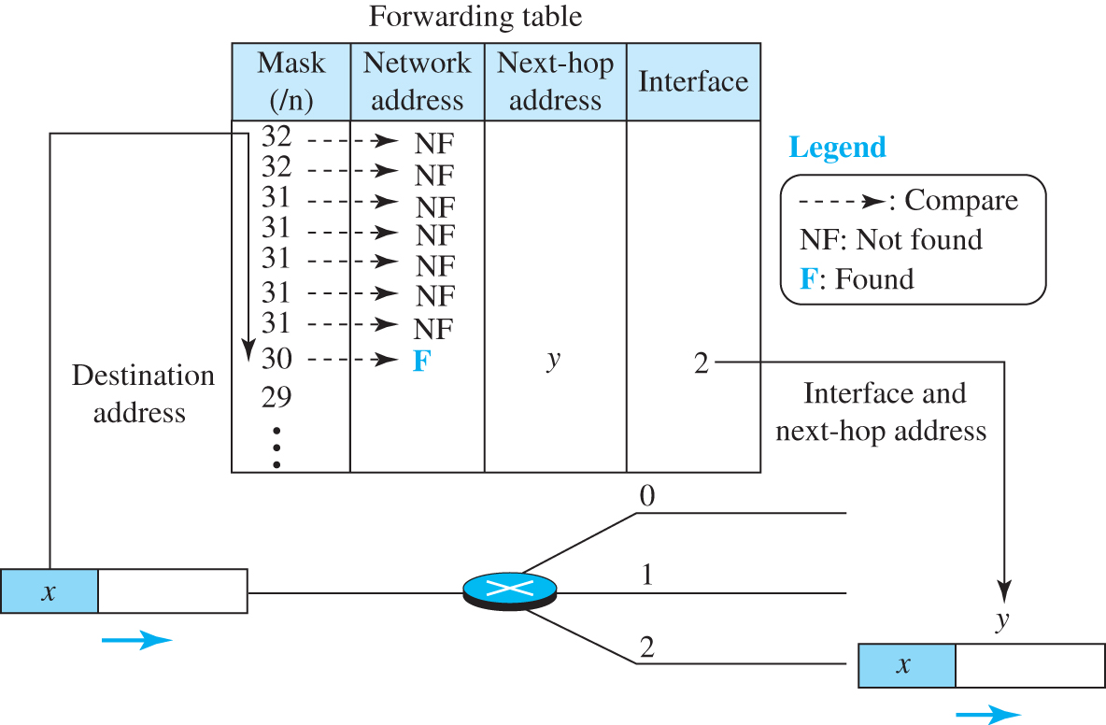
Figure 7.37 Example 7.23
Access the text alternative for slide images.

Slide 124
Example 7.24
Figure 7.38 shows a simple example of using a label to access a switching table. Since the labels are used as the index to the table, finding the information in the table is immediate.

Slide 125
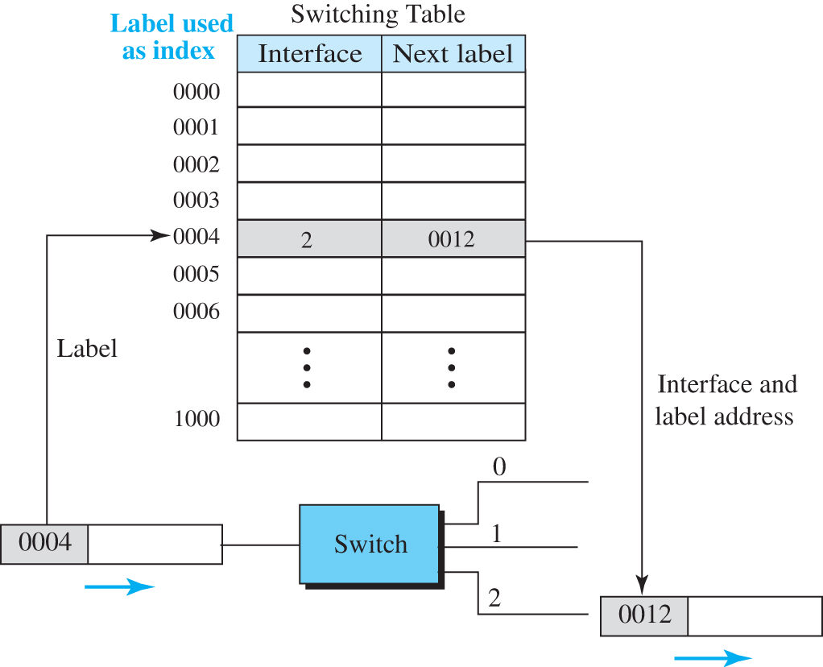
Figure 7.38 Example 7.24
Access the text alternative for slide images.

Slide 126
A New Header
To simulate connection-oriented switching using a protocol like IP, the first thing that is needed is to add a field to the packet that carries the label discussed later. The IPv4 packet format does not allow this extension The solution is to encapsulate the IPv4 packet in an MPLS packet. Figure 7.39 shows the encapsulation.
The MPLS header is actually a stack of subheaders that is used for multilevel hierarchical switching as we will discuss shortly. Figure 7.40 shows the format of an MPLS header in which each subheader is 32 bits (4 bytes) long.

Slide 127
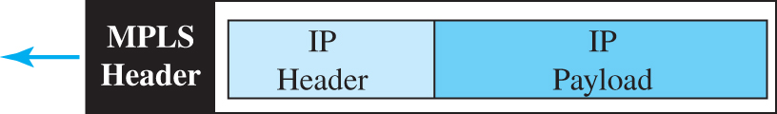
Figure 7.39 MPLS header added to an IP packet

Slide 128
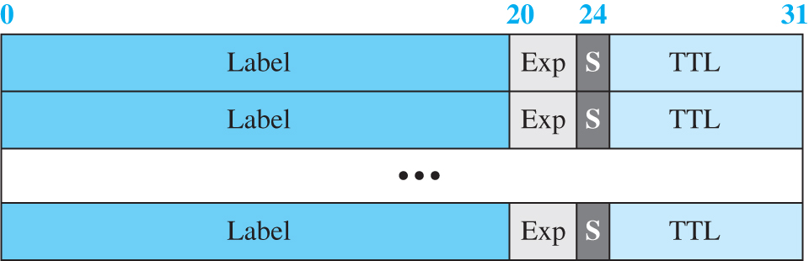
Figure 7.40 MPLS header made of a stack of labels
Access the text alternative for slide images.

Slide 129
Hierarchical Switching
A stack of labels in MPLS allows hierarchical switching. This is similar to conventional hierarchical routing. For example, a packet with two labels can use the top label to forward the packet through switches outside an organization; the bottom label can be used to route the packet inside the organization to reach the destination subnet.

Slide 130
7.4.7 Routers as Packet Switches
A stack of labels in MPLS allows hierarchical switching. This is similar to conventional hierarchical routing. For example, a packet with two labels can use the top label to forward the packet through switches outside an organization; the bottom label can be used to route the packet inside the organization to reach the destination subnet.

Slide 131
7.5 NEXT GENERATION IP (IPv6)
The address depletion of IPv4 and other shortcoming of this protocol prompted a new version of IP protocol in the early 1990s, which is called Internet Protocol version 6 (IPv6) or IP new generation (Ipng).

Slide 132
7.5.1 IPv6 Addressing
The main reason for migration from IPv4 to IPv6 was the small size of the address space of IPv4. An IPv6 address is 128 bytes or 16 bytes, four times the address length in IPv4.

Slide 133
Representation
An IPv6 address is 128 bits or 16 bytes long; four times the address length of IPv4.
Binary (128 bits) 11111110111101101011 … 1111111100000000
Colon hexadecimal FEF6:BA98:7654:3210:ADEF:BBFF:2922:FF00

Slide 134
Address Space 2
The address space of IPv6 contains 2¹²⁸ addresses. This address space is 2⁹⁶ times the IPv4 address—definitely no address depletion—as shown, the size of the space is
340, 282, 366, 920, 938, 463, 374, 607, 431, 768, 211, 456

Slide 135
Address Space Allocation
Like the address space of IPv4, the address space of IPv6 is divided into several blocks of varying size and each block is allocated for a special purpose. Most of the blocks are still unassigned and have been set aside for future use. Table 7.5 shows only the assigned blocks. In this table, the last column shows the fraction each block occupies in the whole address space.

Slide 136
Table 7.5 Prefixes for assigned IPv6 addresses
Block prefix | CIDR | Block assignment | Fraction
0000 0000 | 0000::/8 | Special addresses | 1/256
001 | 2000::/3 | Global unicast | 1/8
1111 110 | FC00::/7 | Unique local unicast | 1/128
1111 1110 10 | FE80::/10 | Link local addresses | 1/1024
1111 1111 | FF00::/8 | Multicast addresses | 1/256

Slide 137
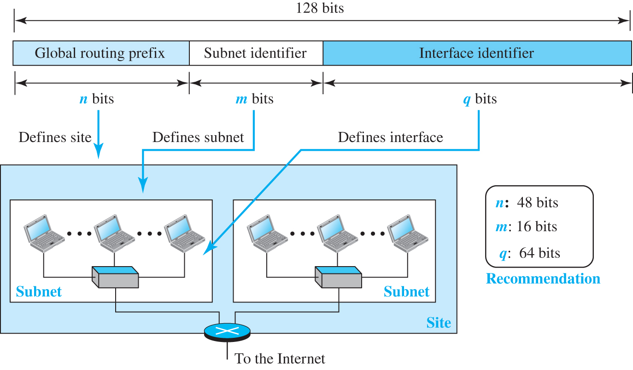
Figure 7.41 Global unicast address
Access the text alternative for slide images.

Slide 138
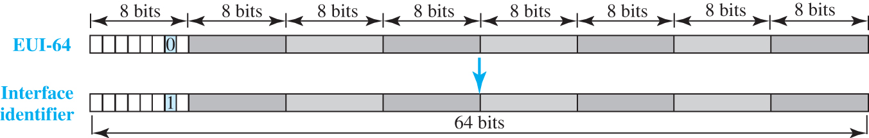
Figure 7.42 Mapping EUI-64
Access the text alternative for slide images.

Slide 139
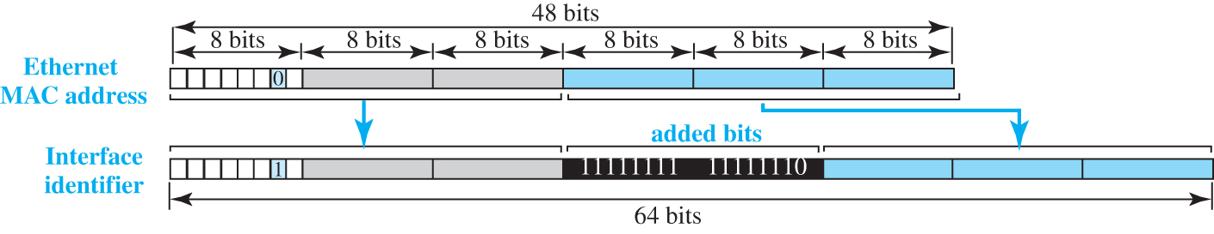
Figure 7.43 Mapping for Ethernet MAC
Access the text alternative for slide images.

Slide 140
Example 7.25
An organization is assigned the block 2000:1456:2474/48. What is the CIDR notation for the blocks in the first and second subnets in this organization.
Solution
Theoretically, the first and second subnets should use the block with subnet identifier
This means that the blocks are
2000:1456:2474:0000/64
and
2000:1456:2474:0001/64.

Slide 141
Example 7.26
Find the interface identifier if the physical address in the EUI is
using the format we defined for Ethernet addresses.
Solution
We only need to change the seventh bit of the first octet from 0 to 1 and change the format to colon hex notation. The result is F7A9:23EF:0714:7AD2.

Slide 142
Example 7.27
Find the interface identifier if the Ethernet physical address is
using the format we defined for Ethernet addresses.
Solution
We only need to change the seventh bit of the first octet from 0 to 1, insert two octet FFFE₁₆ and change the format to colon hex notation. The result is F7A9:23FF:FE14:7AD2 in colon hex.

Slide 143
Example 7.28
An organization is assigned the block 2000:1456:2474/48. What is the IPv6 address of an interface in the third subnet if the IEEE physical address of the computer is
Solution
The interface identifier for this interface is
F7A9:23FF:FE14:7AD2.
If we assign this identifier to the global prefix and the subnet identifier, we get
2000:1456:2474:0003:F7A9:23FF:FE14:7AD2/128

Slide 144
Special Addresses
After discussing the global unicast block, let us discuss the characteristics and purposes of assigned and reserved blocks in the first row of Table 7.5. Addresses that use the prefix (0000::/8) are reserved, but part of this block is used to define some special addresses. Figure 7.44 shows the assigned addresses in this block.

Slide 145
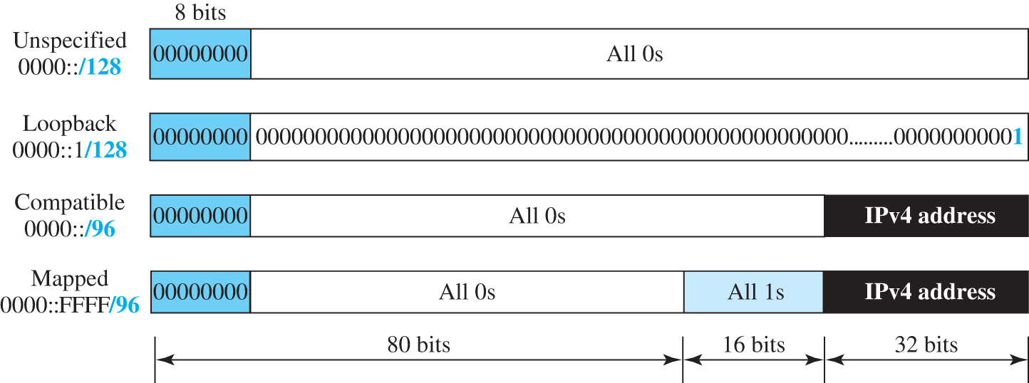
Figure 7.44 Special addresses
Access the text alternative for slide images.

Slide 146
Other Assigned Blocks
IPv6 uses two large blocks for private addressing and one large block for multicasting, as shown in Figure 7.45.

Slide 147
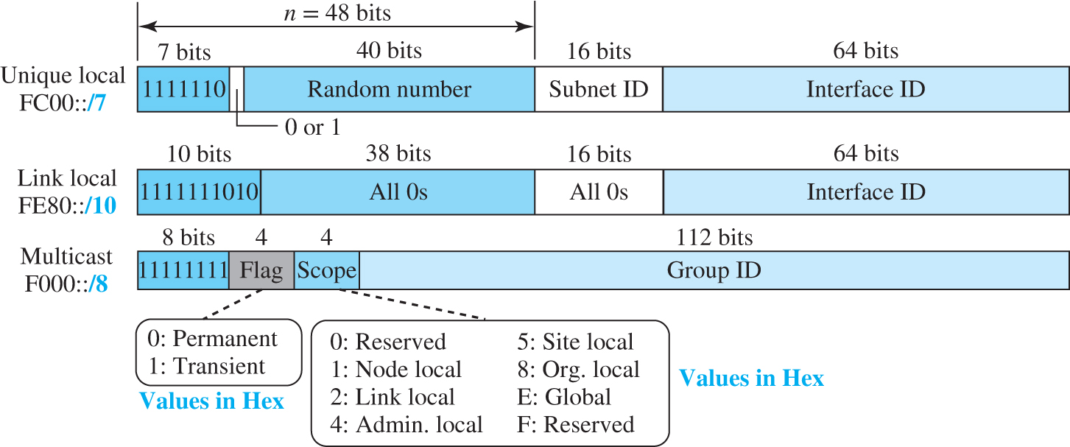
Figure 7.45 Unique local unicast block
Access the text alternative for slide images.

Slide 148
Autoconfiguration
One of the interesting features of IPv6 addressing is the auto-configuration of hosts. As we discussed in IPv4, the host and routers are originally configured manually by the network manager. However, the Dynamic Host Configuration Protocol, DHCP, can be used to allocate an IPv4 address to a host that joins the network. In IPv6, DHCP protocol can still be used to allocate an IPv6 address to a host, but a host can also configure itself.

Slide 149
Example 7.29 (1)
has joined the network. What would be its global unicast address if the global unicast prefix of the organization is 3A21:1216:2165 and the subnet identifier is A245:1232.
Assume a host with Ethernet address
Solution
The host first creates its interface identifier as F7A9:23FF:FE11:9BE2 using the Ethernet address read from its card. The host then creates its link-local address as
FE80::F7A9:23FF:FE11:9BE2

Slide 150
Example 7.29 (2)
Assuming that this address is unique, the host sends a router solicitation message and receives the router advertisement message that announces the combination of global unicast prefix and the subnet identifier as
3A21:1216:2165:A245:1232.
The host then appends its interface identifier to this prefix to find and store its global unicast address as:
3A21:1216:2165:A245:1232:F7A9:23FF:FE11:9BE2

Slide 151
Renumbering
To allow sites to change the service provider, renumbering of the address prefix (n) was built into IPv6 addressing. As we discussed before, each site is given a prefix by the service provider to which it is connected. If the site changes the provider, the address prefix needs to be changed. A router to which the site is connected can advertise a new prefix and let the site use the old prefix for a short time before disabling it. In other words, during the transition period, a site has two prefixes.

Slide 152
7.5.2 The IPv6 Protocol
The change of the IPv6 address size requires the change in the IPv4 packet format. The designer of IPv6 decided to implement remedies for other shortcomings now that a change is inevitable. The following shows other changes implemented in the protocol in addition to changing address size and format.

Slide 153
Packet Format
The IPv6 packet is shown in Figure 7.46. Each packet is composed of a base header followed by the payload. The base header occupies 40 bytes, whereas payload can be up to 65,535 bytes of information. The description of fields follows.

Slide 154
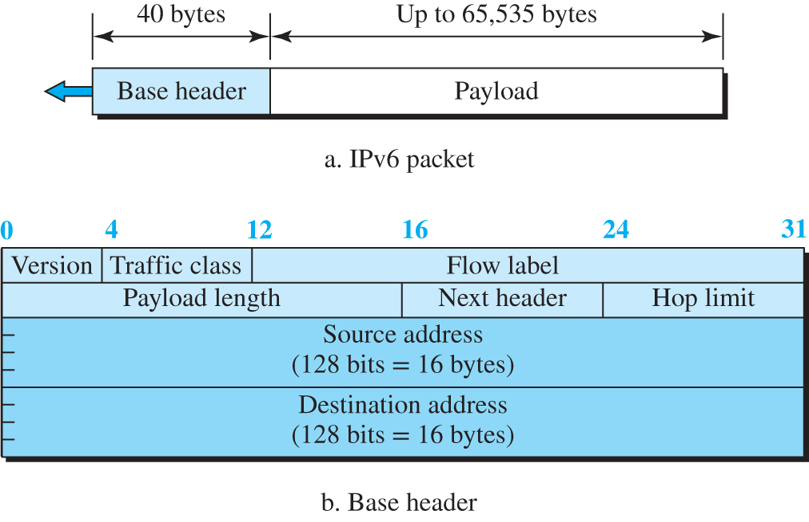
Figure 7.46 IPv6 datagram
Access the text alternative for slide images.

Slide 155
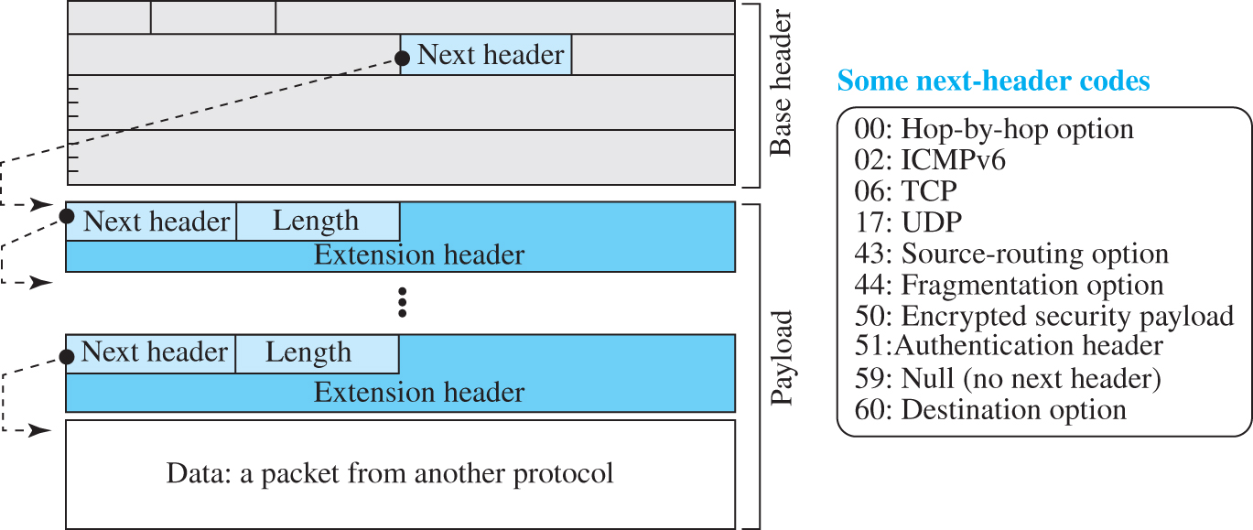
Figure 7.47 Payload in an IPv6 datagram
Access the text alternative for slide images.

Slide 156
Concept of Flow and Priority in IPv6
The IP protocol was originally designed as a connectionless protocol. However, the tendency is to use the IP protocol as a connection-oriented protocol. The MPLS technology described earlier allows us to encapsulate an IPv4 packet in an MPLS header using a label field. In version 6, the flow label has been directly added to the format of the IPv6 datagram to allow us to use IPv6 as a connection-oriented protocol.

Slide 157
Fragmentation and Reassembly
There is still fragmentation and reassembly of datagrams in the IPv6 protocol, but there is a major difference in this respect. IPv6 datagrams can be fragmented only by the source, not by the routers; the reassembly takes place at the destination.

Slide 158
Extension Header
An IPv6 packet is made of a base header and some extension headers. The length of the base header is fixed at 40 bytes. However, to give more functionality to the IP datagram, the base header can be followed by up to six extension headers. Many of these headers are options in IPv4. Six types of extension headers have been defined. These are hop-by-hop option, source routing, fragmentation, authentication, encrypted security payload, and destination option (see Figure 7.48).

Slide 159
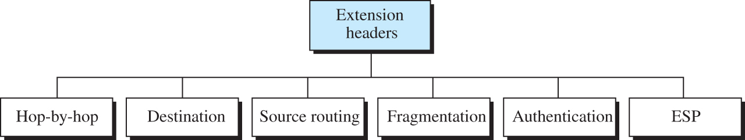
Figure 7.48 Extension headers

Slide 160
Comparison of Options (IPv4 and IPv6) 1
The following shows a quick comparison between the options used in IPv4 and the options used in IPv6.
The no-operation and end-of-option options are replaced by Pad1 and PadN.
The record route option is not implemented in IPv6 because it was not used.
The timestamp option is not implemented because it was not used.
The source route option is called the source route extension header in IPv6.

Slide 161
Comparison of Options (IPv4 and IPv6) 2
The following shows a quick comparison between the options used in IPv4 and the options used in IPv6.
The fragmentation fields in the base header section of IPv4 have moved to the fragmentation extension header in IPv6.
The authentication extension header is new in IPv6.
The encrypted security payload extension header is new in IPv6.

Slide 162
7.5.3 The ICMPv6 Protocol
Another protocol that has been modified in version 6 of the TCP/IP protocol suite is ICMP. This new version, ICMPv6, follows the same strategy and purposes of version 4. ICMPv6, however, is more complicated than ICMPv4: some protocols that were independent in version 4 are now part of ICMPv6 and some new messages have been added to make it more useful.

Slide 163
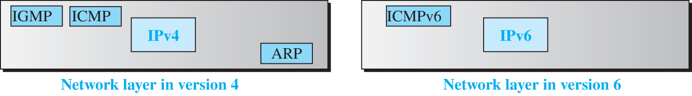
Figure 7.49 Comparison of network layer in version 4 and version 6
Access the text alternative for slide images.

Slide 164

Figure 7.50 Categories of ICMPv6 messages
Access the text alternative for slide images.

Slide 165
Error-Reporting Messages
As we saw in our discussion of version 4, one of the main responsibilities of ICMPv6 is to report errors. Four types of errors are handled: destination unreachable, packet too big, time exceeded, and parameter problems. Note that the source-quenched message, which is used to control congestion in version 4, is eliminated in this version because the priority and flow label fields in IPv6 are supposed to take care of congestion.

Slide 166
Neighbor-Discovery Messages
Several messages in ICMPv4 have been redefined in ICMPv6 to handle the issue of neighbor discovery. Some new messages have also been added to provide extension. The most important issue is the definition of two new protocols that clearly define the functionality of these group messages: the Neighbor-Discovery (ND) protocol and the Inverse-Neighbor-Discovery (IND) protocol.

Slide 167
Group Membership Messages
The management of multicast delivery handling in IPv4 is given to the IGMPv3 protocol. In IPv6, this responsibility is given to the Multicast Listener Delivery protocol. MLDv1 is the counterpart to IGMPv2; MLDv2 is the counterpart to IGMPv3. The
material discussed in this section is taken from RFC 3810. The idea is the same as we discussed in IGMPv3, but the sizes and formats of the messages have been changed to fit the larger multicast address size in IPv6. Like IGMPv3, MLDv2 has two types of messages: membership-query message and membership-report message.

Slide 168
7-6 TRANSITION FROM IPv4 TO IPv6
Although we have a new version of the IP protocol, how can we make the transition to stop using IPv4 and start using IPv6? in the Internet can move The transition must be smooth to prevent any problems between IPv4 and IPv6 systems.

Slide 169
7.6.1 Strategies
Three strategies have been devised for transition: dual stack, tunneling, and header translation. One or all of these three strategies can be implemented during the transition period.

Slide 170
Dual Stack
It is recommended that all hosts, before migrating completely to version 6, have a dual stack of protocols during the transition. In other words, a station must run IPv4 and IPv6 simultaneously until all the Internet uses IPv6. See Figure 7.51 for the layout of a dual-stack configuration

Slide 171

Figure 7.51 Dual stack
Access the text alternative for slide images.

Slide 172
Tunneling
Tunneling is a strategy used when two computers using IPv6 want to communicate with each other and the packet must pass through a region that uses IPv4. To pass through this region, the packet must have an IPv4 address. So the IPv6 packet is encapsulated in an IPv4 packet when it enters the region, and it leaves its capsule when it exits the region. It seems as if the IPv6 packet goes through a tunnel at one end and emerges at the other end. To make it clear that the IPv4 packet is carrying an IPv6 packet as data, the protocol value is set to 41. Tunneling is shown in Figure 7.52.

Slide 173

Figure 7.52 Tunneling strategy
Access the text alternative for slide images.

Slide 174
Header Translation
Header translation is necessary when the majority of the Internet has moved to IPv6 but some systems still use IPv4. The sender wants to use IPv6, but the receiver does not understand IPv6. Tunneling does not work in this situation because the packet must be in the IPv4 format to be understood by the receiver. In this case, the header format must be totally changed through header translation. The header of the IPv6 packet is converted to an IPv4 header (see Figure 7.53).

Slide 175

Figure 7.53 Header translation strategy
Access the text alternative for slide images.

Slide 176
End of Main Content
© 2022 McGraw Hill, LLC. All rights reserved. Authorized only for instructor use in the classroom.
No reproduction or further distribution permitted without the prior written consent of McGraw Hill, LLC.

Slide 177
Accessibility Content: Text Alternatives for Images

Slide 178
Figure 7.1 Communication at the network layer - Text Alternative
Return to parent-slide containing images.
The sky center has two laptops connected to a L A N switch. One of the laptops is labeled as Alice. The L A N switch is connected to R 2 which is further connected to R 4 and R 1. R 1 is connects to other I S Ps. R 4 connects to W A N switch 2 which is further connected between W A N switch 1 and 3. This connection between W A N 1, 2, and 3 is labeled as switched W A N. The W A N switch 1 is connected to R 3 which is further connected to other I S Ps. The W A N switch 3 connects to router R 5 by point-to-point W A N represents National I S P. The router R 5 connects to router R 7 which connects to L A N switch two laptops, and a mainframe shows Bob scientific books. R 7 connects to router R 6 which connects to other I S Ps, by point-point W A N. Alice has application, transport, network, data link, and physical. R 2, R4, R5, and R 7 has physical, data-link, and network. Bob has physical, data-link, network, transport, and application.
Return to parent-slide containing images.

Slide 179
Figure 7.2 Throughput in a path with three links in a series - Text Alternative
Return to parent-slide containing images.
Part A shows a source laptop connects to a router R 1 via link 1 with a 200 kilo byte per second transmission rate. The R 1 connected to router R 2 via link 2 with a 100 kilo byte per second. The R 2 is connected to the destination laptop via link 3 with a 150 kilo byte per second. Part B represents data passage inside a thin cylindrical line in between the thick cylindrical tubular ends.
Return to parent-slide containing images.

Slide 180
Figure 7.3 A path through the Internet backbone - Text Alternative
Return to parent-slide containing images.
A source laptop transmits with a transmission rate T R 1 to two routers that represent backbone with a very high transmission rate, then transfers to destination laptop with a transmission rate of T R 2.
Return to parent-slide containing images.

Slide 181
Figure 7.4 Three different notations in IPv4 addressing - Text Alternative
Return to parent-slide containing images.
The hexadecimal represents 8 0 0 B 0 3 1 F. A two way arrow points between hexadecimal and dotted decimal. The dotted decimal represents 128, 11, 3, 31. Four two way arrow points between dotted decimal and binary. The binary represents 10000000, 00001011, 00000011, and 00011111. The first two-way arrow points between the dotted decimal 128 and the binary 10000000. The second two-way arrow points between the dotted decimal 11 and the binary 00001011. The third two-way arrow points between the dotted decimal 3 and the binary 00000011. The fourth two-way arrow points between the dotted decimal 31 and the binary 00011111.
Return to parent-slide containing images.

Slide 182
Figure 7.5 Hierarchy in addressing - Text Alternative
Return to parent-slide containing images.
Three laptops connect to a switch represents a network. The 32 bits show n bits and (32 minus n) bits. The n bits represent prefixes, and the (32 minus n) bits represent suffixes. The prefix defines the network, and the suffix establishes the connection to the node.
Return to parent-slide containing images.

Slide 183
Figure 7.6 Occupation of the address space in classful addressing - Text Alternative
Return to parent-slide containing images.
The address space has 4,294,967,296 addresses. Class A shares 50 percent of the address space, class B shares 25 percent of the address space, class C shares 12.5 percent of the address space, class D shares 6.25 percent of the address space, and class E shares 6.25 percent of address space. Divisions of four 8 bits given. Class A exhibits 0 prefixes in the first 8 bits and suffixes in the rest of the three 8 bits. Class B demonstrates 10 prefixes in two 8 bits and suffix in the rest of the two 8 bits. Class C exhibits 1 1 0 prefixes in three 8 bits and suffixes in the rest of the one 8 bits. Class D displays 1 1 1 0 exhibits multicast addresses in the four 8 bits. Class E exhibits 1 1 1 1 reserved for future use in the four 8 bits. Class A represents prefixes of n equals 8 bits and the first byte of 0 to 127. Class B shows the prefixes of n is equal to 16 bits and the first byte of 128 to 191. Class C represents prefixes of n is equal to 24 bits and the first byte of 192 to 223. Class D represents prefixes of the not applicable and first byte of 224 to 239. Class E represents prefixes of the not usable and first byte of 240 to 255.
Return to parent-slide containing images.

Slide 184
Figure 7.7 Variable-length blocks in classless addressing - Text Alternative
Return to parent-slide containing images.
The address space represents block 1, block 2, block i, block (m minus 1), and block m. The Blocks 1 and 2 are attached and Blocks (m minus 1) and m are attached. The Block 2 is connected to Block i with point to point W A N connection. The Block i is connected to Block (m minus 1) with point to point W A N connection.
Return to parent-slide containing images.

Slide 185
Figure 7.8 Slash notation (CIDR) - Text Alternative
Return to parent-slide containing images.
Nine bars arranged serially. Bar 1 represents a byte. Bar 2 represents dot. Bar 3 represents a byte. Bar 4 represents dot. Bar 5 represents a byte. Bar 6 represents dot. Bar 7 represents a byte. Bar 8 represents a slash. Bar 9 represents n which refers to prefix length. Examples include 1 2 dot 2 4 dot 7 6 dot 8 slash 8, 2 3 dot 1 4 dot 6 7 dot 9 2 slash 1 2, and 2 2 0 dot 8 dot 2 4 dot 2 5 5 slash 2 5.
Return to parent-slide containing images.

Slide 186
Figure 7.9 Network address - Text Alternative
Return to parent-slide containing images.
Network 1, 2, and m are connected to a router. The routing process establishes the destination address to find the network address. A forwarding table shows the network address, b 1 dot c 1 dot d 1 dot e 1, with interface 1, b 2 dot c 2 dot d 2 dot e 2 with interface 2 dot and b m dot c m dot d m dot e m with interface m.
Return to parent-slide containing images.

Slide 187
Figure 7.10 Solution to Example 4.5 - Text Alternative
Return to parent-slide containing images.
The original block represents a rectangle bar with the label of n is equal to 24. The starting position shows 1 4 dot 2 4 dot 7 4 dot 0 slash 2 4 that represents the first address, and the last place shows 1 4 dot 2 4 dot 7 4 dot 2 5 5 slash 2 4 that represents the previous address. The full rectangle bar shows N is equal to 2 5 6 addresses. The sub blocks offer a rectangle bar with n is equal to 25 and represents 1 4 dot 2 4 dot 7 4 dot 0 slash 2 5 with N is equal to 1 2 8, a second bar with n is equal to 2 6 represents 1 4 dot 2 4 dot 7 4 dot 1 2 8 slash 2 6 with 64, third bar with 2 8 represents 1 4 dot 2 4 dot 1 9 2 dot 0 slash 2 8 with 16, and fourth bar unused with 48.
Return to parent-slide containing images.

Slide 188
Figure 7.11 Example of address aggregation - Text Alternative
Return to parent-slide containing images.
Four blocks connect to a router represents larger block I S P. The Block 1 has 1 6 0 dot 7 0 dot 1 4 dot 0 slash 2 6 to 1 6 0 dot 7 0 dot 1 4 dot 6 3 slash 2 6. The Block 2 has 1 6 0 dot 7 0 dot 1 4 dot 6 4 slash 2 6 to 1 6 0 dot 7 0 dot 1 4 dot 1 2 7 slash 2 6. The Block 3 has 1 6 0 dot 7 0 dot 1 4 dot 1 2 8 slash 2 6 to 1 6 0 dot 7 0 dot 1 4 dot 1 9 1 slash 2 6. The Block 4 has 1 6 0 dot 7 0 dot 1 4 dot 1 9 2 slash 2 6 to 1 6 0 dot 7 0 dot 1 4 dot 2 5 5 slash 2 6. The larger block to internet with all packets with destination addresses 1 6 0 dot 7 0 dot 1 4 dot 0 slash 2 4 to 1 6 0 dot 7 0 dot 1 4 dot 2 5 5 slash 2 4 are sent to I S P.
Return to parent-slide containing images.

Slide 189
Figure 7.12 Position of IP and other network-layer protocols in TCP/IP protocol suite - Text Alternative
Return to parent-slide containing images.
The physical layer and data-link layer represent underlying L A N or W A N technology. Network layer includes I G M P, I C M P, I P and A R P. Transport layer includes S C T P, T C P, and U D P. Application layer includes S M T P, F T P, T E L N E T, D N S, S N M P, three dots D H C P.
Return to parent-slide containing images.

Slide 190
Figure 7.13 IP datagram - Text Alternative
Return to parent-slide containing images.
The I P datagram represents header with 20 to 60 bytes and payload, where the total of header and payload represents 20 to 65, 535 bytes. The header format shows options plus padding 0 to 40 bytes from 0 to 31, destination I P address (32 bits) from 0 to 3 1, source I P address (3 2 bits) from 0 to 31, time-to-live 8 bits from 0 to 8. And protocol 8 bits from 8 to 16 and header checksum 16 bits from 16 to 31, identification 16 bits from 0 to 16, flags 3 bits (block D M) and fragmentation offset 13 bits from 16 to 31, and version number 4 bits from 0 to 4, header length byte from 4 to 8, service type 8 bits from 8 to 16 and total length 16 bits from 16 to 31.
Return to parent-slide containing images.

Slide 191
Figure 7.14 Multiplexing and demultiplexing using the value of the protocol field - Text Alternative
Return to parent-slide containing images.
The network layer includes a rectangle bar representing a datagram with payload connected with I C M P, I G M P, and O S P F inside the network layer and T C P and U D P in the transport layer. The transport layer includes three dots, T C P and U D P. Some protocol values include I C M P 0 1, I G M P 0 2, T C P 0 6, U D P 1 7, and O S P F 89.
Return to parent-slide containing images.

Slide 192
Figure 7.15 Example of checksum calculation - Text Alternative
Return to parent-slide containing images.
Five layers are shown. The first layer has 4, 5, 0, and 28. The second layer shows 49 dot 1 5 3, 0 and 0. The third layer shows 4, 17, and 0. The fourth layer shows 10 dot 12 dot 14 dot 5. The fifth layer shows 12 dot 6 dot 7 dot 9. 4, 5 and 0 represents 4 5 0 0, 28 represents 0 0 1 C, 49 dot 1 5 3 represents C 0 0 1, 0 and 0 represents 0 0 0 0, 4 and 17 represents 0 4 1 1, 0 represents 0 0 0 0, 10.1 2 represents 0 A 0 C, 14.5 represents 0 E 0 5, 12.6 represents 0 C 0 6, 7.9 represents 0 7 0 9, sum represents 1 3 4 4 E, wrapped sum represents 3 4 4 F and check sum represents C B B 0 represents the new checksum, C B B 0 is inserted in the checksum field.
Return to parent-slide containing images.

Slide 193
Figure 7.16 Maximum transfer unit (MTU) - Text Alternative
Return to parent-slide containing images.
The I P datagram represents a layer with header and payload. The second layer has header, frame payload, trailer, frame. The size of frame payload is frame payload size which represents the maximum size of frame payload. An arrow from payload leads to frame payload.
Return to parent-slide containing images.

Slide 194
Figure 7.17 Fragmentation example - Text Alternative
Return to parent-slide containing images.
A horizontal rectangular bar is shown from byte 0 0 0 0 to byte 3999 with offset is equal to 0 0 0 0 slash 8 equal to 0. The horizontal rectangle bar is connected to three rectangular bars. First bar is represented from 0 0 0 0 to 1399 with offset is equal to 0 0 0 0 slash 8 is equal to 0. The second bar is represented from 1400 to 2799 with an offset is equal to 1400 slash 8 is equal to 175. The third bar is represented from 2800 to 3999 with offset is equal to 2800 slash 8 is equal to 350.
Return to parent-slide containing images.

Slide 195
Figure 7.18 Detailed fragmentation example - Text Alternative
Return to parent-slide containing images.
A laptop represents the original which transmits fragment 3, fragments 2, fragments 1 to a first router, fragment 3, and fragment 1 to a second router. The first router transmits F 2. 2 and F 2. 1 to the third router. The third router transmits F 2. 2 and F 2.1 to the second router. The second router transmits F 2.2, F 2.1, F 3, and F 1 to reassemble. The original datagram represents bytes 0 0 0 0 to 3999, 1 and 4 0 2 0, 14,567, 1, 0 and 0 0 0 offset transmits to three fragments F 1, F 2 and F 3. F 1 represents bytes 0 0 0 0 to 1399 with 1 and 1420, ad 14,567, 1 and 0 0 0 offset. The F 2 represents bytes 1400 to 2799 with 1 and 1420 and 14,567, 1, and 175 offsets. The F 3 represents bytes 2800 to 3999 with 1 and 1220, 14,567, 0, and 350 offsets. The F 2 transmits to two fragments F 2 dot 1 and F 2 dot 2. The F dot 2 dot 1 represents bytes 1400 to 2199 with 1 and 820, 14,567, and 1 and 175. The F dot 2 dot 1 represents bytes 2200 to 2799 with 1 and 620, 14,567, and 1 and 275 offsets.
Return to parent-slide containing images.

Slide 196
Figure 7.19 General format of ICMP messages - Text Alternative
Return to parent-slide containing images.
Error-reporting messages show data section, rest of the header and type 8 bits, code 8 bits, and checksum 16 bits. The query messages represent data section, identifier, and sequence number and type 8 bits, code 8 bits, and checksum 16 bits. The type and code values of error-reporting messages are 03: destination unreachable (codes 0 to 15), 04: source quench (only code 0), 05: redirection (codes 0 to 3), 11: time exceeded (codes 0 and 1) and 12: parameter problem (codes 0 and 1). The type and code values of query messages are 08 and 00: echo request and reply (only code 0) and 13 and 14: timestamp request and reply (only code 0).
Return to parent-slide containing images.

Slide 197
Figure 7.20 Contents of data field for error messages - Text Alternative
Return to parent-slide containing images.
The received datagram represents the I P header, 8 bytes, and the rest of the I P data. The I C M P packet has I P header, I C M P header, and 8 bytes. The sent I P datagram has I P header, I C M P header, I P header with leftward arrow, and 8 bytes.
Return to parent-slide containing images.

Slide 198
Figure 7.21 Example of traceroute program - Text Alternative
Return to parent-slide containing images.
A laptop 1 connects to router 1, router 2, and router 3 to a laptop 2. Laptop 1 transmits echo request T T L 1 to router 1, T T L 2 to router 2, T T L 3 to router 3, and T T L 4 to laptop 2. Router 1, Router 2, and Router 3 shows time-exceeded to laptop 1. Laptop 1 transmits echo requests. Laptop 2 offers destination-unreachable to laptop 1.
Return to parent-slide containing images.

Slide 199
Figure 7.22 Example of checksum calculation - Text Alternative
Return to parent-slide containing images.
A rectangle box with three layers represents TEST, 1 and 9 and 8 0 0. 8 and 0 represents 0 0 0 0 1 0 0 0 0 0 0 0 0 0 0 0, 0 represents 0 0 0 0 0 0 0 0 0 0 0 0 0 0 0 0, 1 represents 0 0 0 0 0 0 0 0 0 0 0 0 0 0 0 1, 9 represents 0 0 0 0 0 0 0 0 0 0 0 0 1 0 0 1, T and E represents 0 1 0 1 0 1 0 0 0 1 0 0 0 1 0 1, S and T represents 0 1 0 1 0 0 1 1 0 1 0 1 0 1 0 0, sum represents 1 0 1 0 1 1 1 1 1 0 1 0 0 0 1 1 and checksum represents 0 1 0 1 0 0 0 0 0 1 0 1 1 1 0 0 represents the layer 8 0 0.
Return to parent-slide containing images.

Slide 200
Figure 7.23 Home address and care-of address - Text Alternative
Return to parent-slide containing images.
The home network represents a box 1 3 1 dot 5 dot 0 dot 0 slash 1 6, mobile host original home 1 3 1 dot 5 dot 2 4 dot 8 slash 1 6 connects to a router to the internet. Then, router to a Foreign network represents a box with 1 4 dot 0 dot 0 dot 0 slash 8 links to a laptop, the mobile host where care-of address is 1 4 dot 1 3 dot 1 6 dot 9 slash 8 and home address is 1 3 1 dot 5 dot 2 4 dot 8 slash 16.
Return to parent-slide containing images.

Slide 201
Figure 7.24 Home agent and foreign agent - Text Alternative
Return to parent-slide containing images.
The home network represents a box with a mobile host original home connects to a router represents a home agent connects to the internet connects to a router illustrates a foreign agent connects to a foreign network of the box with a laptop shows the mobile host.
Return to parent-slide containing images.

Slide 202
Figure7.25 Remote host and mobile host communication - Text Alternative
Return to parent-slide containing images.
The mobile host at home represents a laptop. The home agent represents a router 1. The foreign agent represents a router 2. The mobile host after the move shows a laptop 2. The remote host shows a laptop 3. Laptop 1 transmits agent solicitation to router 1 of the home agent. The home agent router 1 transfers agent advertisement to laptop 1, the mobile host after move laptop 2 transfers agent solicitation to router 2 of a foreign agent. Router 2 of foreign agent transmits agent advertisement to laptop 2, where the processes represent phase 1: agent discovery. Laptop 2 transfers a registration request to router 2 of a foreign agent, and router 2 transmits a registration request to router 1 of the home agent. Router 1 of the home agent sends a registration reply to router 2 of a foreign agent. Router 2 of foreign agent transmits registration reply to laptop 2 of mobile host after the move, where the processes represent phase 2 registration. After moving sends, laptop 2 of the mobile host to laptop 3 of the remote host shows phase 3 data transfer.
Return to parent-slide containing images.

Slide 203
Figure 7.26 Agent advertisement - Text Alternative
Return to parent-slide containing images.
A table represents I C M P advertisement message, type, length, and sequence number, lifetime, code and reserved, and care-of addresses (foreign agent only).
Return to parent-slide containing images.

Slide 204
Figure 7.27 Registration request format - Text Alternative
Return to parent-slide containing images.
A table represents a type, flag and lifetime, home address, home agent address, care-of address, identification, and extensions.
Return to parent-slide containing images.

Slide 205
Figure 7.28 Registration reply format - Text Alternative
Return to parent-slide containing images.
A table represents a type, code and lifetime, home address, home agent address, identification, and extensions.
Return to parent-slide containing images.

Slide 206
Figure 7.29 Data transfer - Text Alternative
Return to parent-slide containing images.
The home network has a box that represents the mobile host's original home. The remote network has a package that connects to a laptop, shows the remote host. The foreign network has a box that connects to a computer, represents a mobile host. The small network transmits to a router shows home agent connects to the home network. The home agent that connects to a router represents a foreign agent. The foreign agent joins the mobile host. The mobile host of a foreign network transfers the remote host. The home agent, the router from a small network, and the foreign agent connects the internet.
Return to parent-slide containing images.

Slide 207
Figure 7.30 Double crossing - Text Alternative
Return to parent-slide containing images.
The home network has a box that connects with a router that represents the home agent. The foreign network has a tube attached to two laptops, where one laptop represents a remote host connects to the other laptop, a mobile host, where the connection shows the could-be path. The remote host of the foreign network transfers to the home agent. The home agent transmits to the mobile host of a foreign network. The home agent and foreign agents connect to the internet.
Return to parent-slide containing images.

Slide 208
Figure 7.31 Triangle routing - Text Alternative
Return to parent-slide containing images.
The home network has a box that connects to a router that represents the home agent. The remote network has a box connecting to a laptop representing a remote host and a router. The foreign network has a tube connected to a computer representing a mobile host and a router representing a foreign agent. The remote host relates to the home agent. The home agent sends it to the foreign agent. The remote host attaches to the foreign network, represents the could-be path. The home agent, foreign agent, and the router of the small network connected to the internet.
Return to parent-slide containing images.

Slide 209
Figure 7.32 Simplified forwarding module in classless address - Text Alternative
Return to parent-slide containing images.
Packet transmits to extract destination address conveys to search table represents a forwarding table. The search table sends to other modules or protocols represents interface number and next-hop address. A router shows connections to m0, m1, and m2. The forwarding table represents network address including mask, next-hop I P address, and interface: x 0 dot y 0 dot z 0 dot t 0 slash n 0, dots and m0; x 1 dot y 1 dot z 1 dot t 1 slash n 1, dots and m 1; x 2 dot y 2 dot z 2 dot t 2 slash n 1, dots and m 2.
Return to parent-slide containing images.

Slide 210
Figure 7.33 Configuration for Example 7.19 - Text Alternative
Return to parent-slide containing images.
A router labeled as R 1 connects to a box represents 2 0 1 dot 4 dot 1 6 dot 0 slash 2 2 and 2 0 1 dot 4 dot 1 6 dot 2 slash 2 2 represents m 1, a box represents 1 8 0 dot 7 0 dot 6 5 dot 1 2 8 slash 2 5 and 1 8 0 dot 7 0 dot 6 5 dot 1 3 5 slash 2 5 represents m 0, a box represents 2 0 1 dot 4 dot 2 2 dot 0 slash 2 4 and 2 0 1 dot 4 dot 2 2 dot 3 slash 2 4 represents m 3 and a box represents 1 8 0 dot 7 0 dot 6 5 dot 1 9 4 slash 2 6 and 1 8 0 dot 7 0 dot 6 5 dot 1 9 2 slash 2 6 represents m 2 and connects to router represents 1 8 0 dot 7 0 dot 6 5 dot 2 0 0 slash 2 6 and to rest of the internet.
Return to parent-slide containing images.

Slide 211
Figure 7.34 Address aggregation - Text Alternative
Return to parent-slide containing images.
A router labeled as R 1 connects to organization 1 with 1 4 0 dot 2 4 dot 7 dot 0 slash 2 6 represents m 0, organization 2 with 1 4 0 dot 2 4 dot 7 dot 6 4 slash 2 6 represents m 1, organization 3 with 1 4 0 dot 2 4 dot 7 dot 1 2 8 slash 2 6 represents m 2 and organization 4 with 1 4 0 dot 2 4 dot 7 dot 1 9 2 slash 2 6 represents m 3. The R 1 connects to a router R 2 somewhere in the internet represents m 4 and m 0. The transmissions from the R 2 represents m 1. The forwarding table for R 1 is network address/mask, next-hop address and interface: 1 4 0 dot 2 4 dot 7 dot 0 slash 2 6, dots and m 0; 1 4 0 dot 2 4 dot 7 dot 6 4 slash 2 6, dots and m 1; 1 4 0 dot 2 4 dot 7 dot 1 2 8 slash 2 6, dots and m 2; 1 4 0 dot 2 4 dot 7 dot 1 9 2 slash 2 6, dots and m 3; and 0 dot 0 dot 0 dot 0 slash 0, address of R 2 and m4. The forwarding table for R 2 is network address/mask, next-hop address and interface: 1 4 0 dot 2 4 dot 7 dot 0 slash 2 4, dots and m 0 and 0 dot 0 dot 0 dot 0 slash 0, default router and m1.
Return to parent-slide containing images.

Slide 212
Figure 7.35 Longest mask addressing - Text Alternative
Return to parent-slide containing images.
A router labeled as R 1 connects to organization 1 with 1 4 0 dot 2 4 dot 7 dot 0 slash 2 6 represents m 0, organization 2 with 1 4 0 dot 2 4 dot 7 dot 6 4 slash 2 6 represents m 1, organization 3 with 1 4 0 dot 2 4 dot 7 dot 1 2 8 slash 2 6 represents m 2. The R 1 connects to a router R 2 represents m 3 and m 0. The R 2 connections to organization 4 with 1 4 0 dot 2 4 dot 7 dot 1 9 2 slash 2 6 represents m 1. The transmissions from the R 2 represents m 2. The forwarding table for R 1 is network address/mask, next-hop address and interface: 1 4 0 dot 2 4 dot 7 dot 0 slash 2 6, dots and m 0; 1 4 0 dot 2 4 dot 7 dot 6 4 slash 2 6, dots and m 1; 1 4 0 dot 2 4 dot 7 dot 1 2 8 slash 2 6, dots and m 2; and 0 dot 0 dot 0 dot 0 dot 0 slash 0, default router and m 3. The forwarding table for R 2 is network address/mask, next-hop address and interface: 1 4 0 dot 2 4 dot 7 dot 1 9 2 slash 2 6, dots and m 1; 1 4 0 dot 2 4 dot 7 dot 0 slash 2 4, address of R 1 and m 0; and 0 dot 0 dot 0 dot 0 slash 0, default router and m2.
Return to parent-slide containing images.

Slide 213
Figure 7.36 Hierarchical routing with ISPs - Text Alternative
Return to parent-slide containing images.
H 0 0 1 with 1 2 0 dot 1 4 dot 6 4 dot 0 slash 3 0 and H 1 2 8 dots connects to small I S P 1 connects with 1 2 0 dot 1 4 dot 6 4 dot 0 slash 23 and total 5 1 2 to local I S P 1. H 0 0 1 with 1 2 0 dot 1 4 dot 7 8 dot 0 slash 3 0 and H 1 2 8 dots connects to small I S P 8 connects with 1 2 0 dot 1 4 dot 7 8 dot 0 slash 23 and total 5 1 2 to local I S P 1. The local I S P 1 with 1 2 0 dot 1 4 dot 6 4 dot 0 slash 20 with a total of 4 0 9 6 connects to regional I S P. Unused with 1 2 0 dot 1 4 dot 8 0 dot 0 slash 20 with a total of 4 0 9 6 connects to regional I S P. L O r g 0 1 with 1 2 0 dot 1 4 dot 9 6 dot 0 slash 2 2 and L O r g 0 4 dots connects to local I S P 2. The local I S P 2 with 1 2 0 dot 1 4 dot 9 6 dot 0 slash 2 0 with a total of 4 0 9 6 connects to regional I S P. S O r g 0 1 with 1 2 0 dot 1 4 dot 1 1 2 dot 0 slash 2 4 and S O r g 1 6 dots connects to local I S P 3. The local I S P 3 with 1 2 0 dot 1 4 dot 1 1 2 dot 0 slash 2 0 with a total of 4 0 9 6 connects to regional I S P. The regional I S P with 1 2 0 dot 1 4 dot 6 4 dot 0 slash 1 8 and total of 16,384 to the rest of the internet.
Return to parent-slide containing images.

Slide 214
Figure 7.37 Example 7.23 - Text Alternative
Return to parent-slide containing images.
A bar with x represents destination address 32, 32, 31, 31, 31, 31, 31, 31, 30, 29 connects to a router, which has three connects represents 0, 1and 2 to a bar with x and the bar labeled as y, which is from an interface number 2 represents interface and next-hop address. The forwarding table represents mask (slash n), network address, next-hop address, and interface: 32 represents NF. 32 represents N F. 31 represents N F. 31 represents N F. 31 represents N F. 31 represents N F. 31 represents N F. 30 represents F, y, and 2, and 29.
Legend for the image: Rightward arrow denote to Compare, NF denote to Not found, and F denote to Found.
Return to parent-slide containing images.

Slide 215
Figure 7.38 Example 7.24 - Text Alternative
Return to parent-slide containing images.
A bar with 0 0 0 4 represents to label 0004 connects to switch which connects to 0, 1 and 2 represents a bar with 0 0 1 2 represents interface and label address. The switching table represents interface 2, next label 0 0 1 2. The label used as index are 0 0 0 0, 0 0 0 1, 0 0 0 2, 0 0 0 3, 0 0 0 4, 0 0 0 5, 0 0 0 6, dots 1 0 0 0.
Return to parent-slide containing images.

Slide 216
Figure 7.40 MPLS header made of a stack of labels - Text Alternative
Return to parent-slide containing images.
A table represents label from 0 to 20, E x p from 20 to 24, S on 24 and T T L from 24 to 31, a label from 0 to 20, E x p from 20 to 24, S on 24, and T T L from 24 to 31 dots and label from 0 to 20, E x p from 20 to 24, S on 24 and T T L from 24 to 31.
Return to parent-slide containing images.

Slide 217
Figure 7.41 Global unicast address - Text Alternative
Return to parent-slide containing images.
A site represents two subnets of a switch connects to three laptops connected to a router to the internet. The site defines n bits equals 48 bits (recommendation) global routing prefix. The subnet defines m bits shows 16 bits (recommendation) subnet identifiers. The interface defines q bits with 64 bits (recommendation) interface identifiers. The total of a global routing prefix, subnet identifier, and interface identifier is 128 bits.
Return to parent-slide containing images.

Slide 218
Figure 7.42 Mapping EUI-64 - Text Alternative
Return to parent-slide containing images.
A bar labeled as E U I-64 has eight bars of 8 bits. The first bar is divided into eight parts and has 0 in the seventh part. A bar of 64 bits labeled as interface identifier has eight bars, where the first bar is divided into eight bars and has 1 in the seventh part. The E U I-64 shows a down arrow to the interface identifier.
Return to parent-slide containing images.

Slide 219
Figure 7.43 Mapping for Ethernet MAC - Text Alternative
Return to parent-slide containing images.
A bar labeled as Ethernet M A C address has six bars of 8 bits and a total of 48 bits. The first bar is divided into eight parts and has 0 in the seventh part. A bar of 64 bits labeled as interface identifier has eight bars, where the first bar is divided into eight and has 1 in the seventh part, the fourth and fifth bars represent added bits, and the fifth bar has 0 in the eighth part. The first three bars show a down arrow to the first three bars of interface identifier. The last three Ethernet M A C address bars showdown arrow to the last three bars of interface identifier.
Return to parent-slide containing images.

Slide 220
Figure 7.44 Special addresses - Text Alternative
Return to parent-slide containing images.
The unspecified with 0 0 0 0 slash 128 has two bars represents 0 0 0 0 0 0 0 0 in first 8 bits and all 0s. The loopback with 0 0 0 0 dots 1 slash 128 has two bars represents 0 0 0 0 0 0 0 0 in first 8 bits and 0s and 1 in the last. The compatible with 0 0 0 0 dots slash 96 has three bars represents 0 0 0 0 0 0 0 0 in first 8 bits, all 0s in second and I P v 4 address in third bar. The mapped with 0 0 0 0 dots F F F F slash 96 has 4 bars represents 0 0 0 0 0 0 0 0 in first bar, all 0s in second, all 1s in third and I P v 4 address in fourth bar, where the first two bars represents 80 bits, the third represents 16 bits and fourth 32 bits.
Return to parent-slide containing images.

Slide 221
Figure 7.45 Unique local unicast block - Text Alternative
Return to parent-slide containing images.
The unique local FC00:/7 shows 7 bits, 40 bits, 16 bits and 64 bits. The gap between 7 bits and 40 bits is 0 or 1. The total length of 7 bits and 40 bits is n equals 48 bits. The 7 bits shows 1111110; The 40 bits shows random number; the 16 bits shows subnet ID; the 64 bits shows interface ID. The link local FE80:/10 shows 10 bits, 38 bits, 16 bits, and 64 bits. The 10 bits shows 1111111010; the 38 bits shows All 0s; the 16 bits shows All 0s; the 64 bits shows interface ID. The multicast F000:/8 shows 8 bits, 4 bits, 4 bits, and 112 bits. The 8 bits shows 11111111; the 4 bits shows flag with values in hex as 0: Permanent and 1: Transient; the 4 bits shows scope with values in hex as 0: reserved, 1: node local, 2: link local, 4: admin, local, 5: site local, 8: organization local, E: global, and F: reserved; the 112 bits shows group ID.
Return to parent-slide containing images.

Slide 222
Figure 7.46 IPv6 datagram - Text Alternative
Return to parent-slide containing images.
The figure (a) shows I P v 6 packet represents the base header with 40 bytes and a payload of up to 65,535 bytes. An leftward connected from base header. The figure (b) shows The base header includes a first layer of version from 0 to 4, traffic class from 4 to 12 and flow label from 12 to 31, the second layer of payload length from 0 to 16, next header from 16 to 24, and hop limit from 24 to 31, the third layer of the source address (128 bits is equal to 16 bytes) from 0 to 31 and the fourth layer of the destination address (128 bits is equal to 16 bytes).
Return to parent-slide containing images.

Slide 223
Figure 7.47 Payload in an IPv6 datagram - Text Alternative
Return to parent-slide containing images.
The base header has four layers, where the second part of the second layer represents the next header. The payload has many segments with the next header, length and extension header, and a segment data: a packet from another protocol. The next header of the base header transmits to the next header of payload, and the next header of payload transmits to data: a packet from another protocol. Some next-header codes are 00: hop-by-hop option, 02: I C M P v 6, 06: T C P, 17: U D P, 43: source-routing option, 44: fragmentation option, 50: encrypted security payload, 51: authentication header, 59: null (no next header) and 60: destination option.
Return to parent-slide containing images.

Slide 224
Figure 7.49 Comparison of network layer in version 4 and version 6 - Text Alternative
Return to parent-slide containing images.
The network layer in version 4 includes I G M P, I C M P, I P v 4, and A R P. The network layer in version 6 includes I C M P v 6 and I P v 6.
Return to parent-slide containing images.

Slide 225
Figure 7.50 Categories of ICMPv6 messages - Text Alternative
Return to parent-slide containing images.
The I C M P v 6 messages include error messages, information messages, neighbor discovery messages represent N D protocol, and group membership messages represent M L D protocol.
Return to parent-slide containing images.

Slide 226
Figure 7.51 Dual stack - Text Alternative
Return to parent-slide containing images.
Three layers include upper layers, I P v 4 and I P v 6 layer, and two layers of underlying L A N or W A N technology. The left side represents to and from I P v 4 system and the right side represents To and from I P v 6 system.
Return to parent-slide containing images.

Slide 227
Figure 7.52 Tunneling strategy - Text Alternative
Return to parent-slide containing images.
A laptop labeled as I P v 6 host transmits to a router represents I P v 6 header payload sends to the small router. A router represents I P v 4 and tunnel of I P v 4 header, I P v 6 header and payload, transmits to a laptop labeled as I P v 6 host represents I P v 6 header payload.
Return to parent-slide containing images.

Slide 228
Figure 7.53 Header translation strategy - Text Alternative
Return to parent-slide containing images.
A laptop labeled as I P v 6 host transmits through I P v 6 region. It represents I P v 6 header, and payload to router represents header translation done here, to a laptop labeled as I P v 4 host shows I P v 4 region and I P v 4 header and payload.
Return to parent-slide containing images.

